Slide 1

Ambiguity in the mind and the lexicon
Sean Trott
June 14, 2022

Slide 2
Structure of this talk
Why study ambiguity?
Ambiguity in the lexicon: why is there so much of it?

Slide 3
Why study ambiguity?
It’s pervasive.
In English, between 60-80% of words have multiple meanings.
Rodd et al., 2004
The most frequent words are also the most ambiguous.
Zipf, 1949; Piantadosi et al., 2012
Ambiguity is the rule, not the exception.
Notes:
Estimates vary across languages, but there is general agreement that ambiguity is extremely widespread across all languages.
Emphasize: ambiguity is the rule, not the exception.
Consequently, any “complete” theory of language comprehension, mental representation of meaning, or even why languages look the way they do must contend with ambiguity.

Slide 4
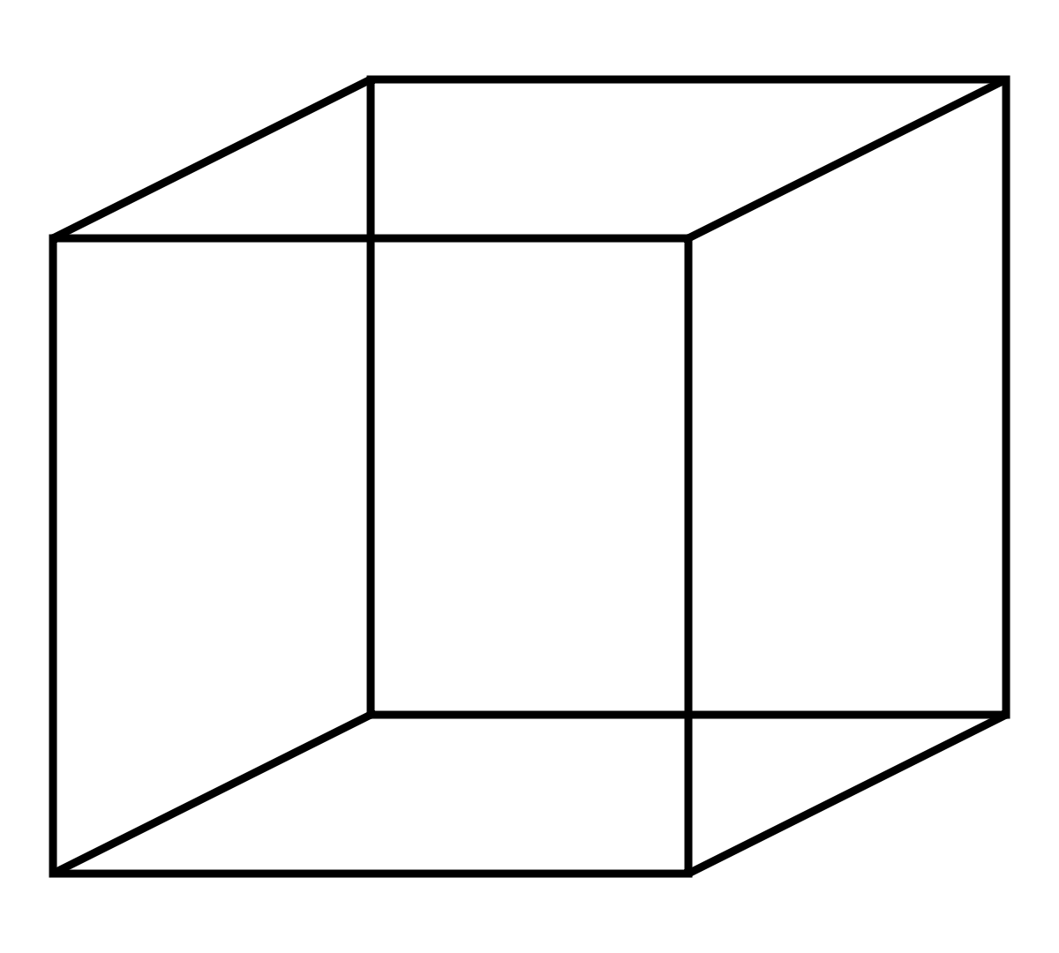
Why study ambiguity?
It’s pervasive.
It’s instrumentally useful.
Ambiguous visual stimuli have taught us much about visual perception.
Leopold & Logothetis, 1999;
Long & Toppino, 2004
Notes:
Ambiguity is also instrumentally useful––as a tool to probe the mind, as well as the possibility of competing pressures that operate over language.
Ambiguous visual stimuli → produce “multistable” perceptions, which researchers have used to the study the processes/dynamics underlying visual perception. Look at things like “rate of reversals”/adaptation, contrast between “bottom-up” vs. “top-down” processes (i.e., you cant “avoid” it, suggesting bottom-up; but there’s also some evidence for something like learning), the role of “fatigue” as it relates to sustaining a particular percept, etc.
Long & Toppino (2004) → point out that “reversible stimuli” have been used to study visual perception since at least 1832 (Robert Necker describes the “Necker Cube”).

Slide 5
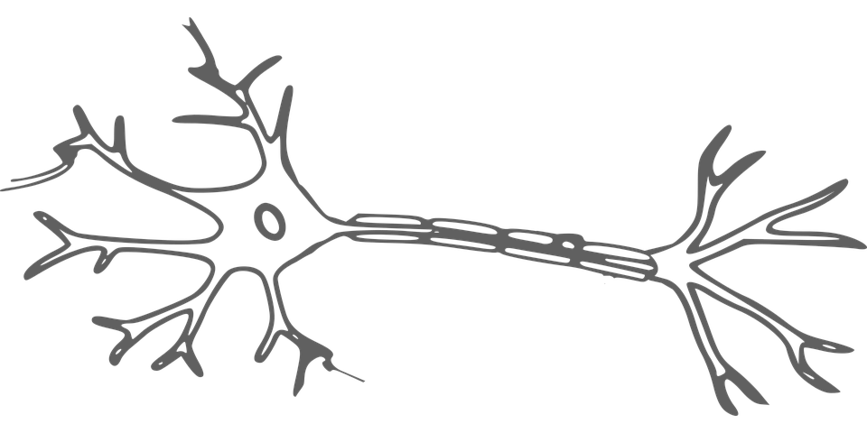
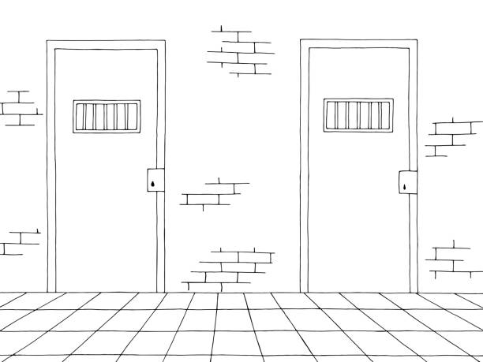
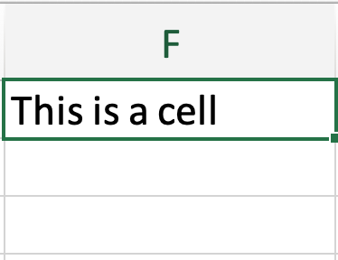

Why study ambiguity?
It’s pervasive.
It’s instrumentally useful.
Cell
Ambiguity in language can also be used to probe the architecture of the language system.
Notes:
Ambiguity is also instrumentally useful––as a tool to probe the mind, as well as the possibility of competing pressures that operate over language.
E.g., for comprehension, b/c the same stimulus can elicit multiple interpretations, that acts as a kind of “control”––and you can then ask how those interpretations can be pushed around given different manipulations of context.
For example, you might ask questions like: which meaning tends to be accessed first? Do people always activate all meanings of an ambiguous word, or do they tend to activate only the most salient one given a particular context? What’s the role of expertise––within this department, some of you might imagine a “brain cell”, while others might be more likely to think about a cell in a data table. (“Table”, notably, is also ambiguous.)
People (e.g., Ferreira) have also used ambiguous words to ask about the role of things like audience design in language production.

Slide 6
Why study ambiguity?
It’s pervasive.
It’s instrumentally useful.
Cell
Ambiguity in language can also be used to probe the architecture of the language system.
Notes:
Ambiguity is also instrumentally useful––as a tool to probe the mind, as well as the possibility of competing pressures that operate over language.
E.g., for comprehension, b/c the same stimulus can elicit multiple interpretations, that acts as a kind of “control”––and you can then ask how those interpretations can be pushed around given different manipulations of context.
For example, you might ask questions like: which meaning tends to be accessed first? Do people always activate all meanings of an ambiguous word, or do they tend to activate only the most salient one given a particular context? What’s the role of expertise––within this department, some of you might imagine a “brain cell”, while others might be more likely to think about a cell in a data table. (“Table”, notably, is also ambiguous.)
People (e.g., Ferreira) have also used ambiguous words to ask about the role of things like audience design in language production.

Slide 7
Why study ambiguity?
It’s pervasive.
It’s instrumentally useful.
Cell
Ambiguity in language can also be used to probe the architecture of the language system.
Notes:
Ambiguity is also instrumentally useful––as a tool to probe the mind, as well as the possibility of competing pressures that operate over language.
E.g., for comprehension, b/c the same stimulus can elicit multiple interpretations, that acts as a kind of “control”––and you can then ask how those interpretations can be pushed around given different manipulations of context.
For example, you might ask questions like: which meaning tends to be accessed first? Do people always activate all meanings of an ambiguous word, or do they tend to activate only the most salient one given a particular context? What’s the role of expertise––within this department, some of you might imagine a “brain cell”, while others might be more likely to think about a cell in a data table. (“Table”, notably, is also ambiguous.)
People (e.g., Ferreira) have also used ambiguous words to ask about the role of things like audience design in language production.

Slide 8
Why is language so ambiguous?

Slide 9
The puzzle of ambiguity
Anywhere from 7%-15% of English wordforms are homophonous: they have ≥2 unrelated meanings.
Presumably, ambiguity––at least marginally––raises the probability of miscommunication.
So why would a system ostensibly evolved for communication tolerate ambiguity?
Trott & Bergen, 2020
“﻿The use of language for communication might turn out to be a kind of epiphenomenon … If you want to make sure that we never misunderstand one another, for that purpose language is not well designed, because you have such properties as ambiguity.”
-(Chomsky, 2002, pg. 107).

Slide 10
Ambiguity is tolerated
Humans have a remarkable capacity to disambiguate.
Levinson, 2000; Wasow et al, 2005; Ferreira, 2008; Piantadosi et al, 2012
Homophones can be disambiguated using:
Grammatical class
Co-speech gesture
Linguistic context
Dautriche et al, 2018
Holle & Gunter, 2007; Holler & Beattie, 2003; Kidd & Holler, 2009
Aina et al, 2019;
Beekhuizen et al, 2019
Up to a limit, lexical ambiguity is tolerated––i.e., not selected against.
But is it selected for?

Slide 11
Ambiguity as a design feature
A well-designed lexicon should favor easy wordforms.
Combined with a tolerance for ambiguity, this could create a direct pressure to recycle the most optimal forms for multiple meanings.
Indeed, homophony is concentrated among short, frequent, and phonotactically plausible wordforms in English, Dutch, and German.
Zipf, 1949; Piantadosi et al, 2012
But there’s an alternative explanation that hasn’t been accounted for.

Slide 12
Ambiguity as a byproduct
Phonotactic constraints narrow the space of possible wordforms.
Dautriche et al, 2017
Proportion of occupied phonotactic space will always be larger for short wordforms.
Number of possible wordforms grows (roughly) exponentially with word length.
But number of actual words does not.
Even adding words randomly would result in more monosyllabic homophones, simply by chance.
Notes:
But number of actual words does not: ~7k monosyllabic English words, ~15k bisyllabic words, ~11k trisyllabic words, etc.

Slide 13
Ambiguity as a byproduct
Phonotactic constraints narrow the space of possible wordforms.
Dautriche et al, 2017
Proportion of occupied phonotactic space will always be larger for short wordforms.
How much of the empirical distribution of homophony is attributable to these indirect factors––vs. a direct pressure to “recycle” the best wordforms?
We need a baseline.
Notes:
But number of actual words does not: ~7k monosyllabic English words, ~15k bisyllabic words, ~11k trisyllabic words, etc.

Slide 14
A baseline for ambiguity
We’d like to know how many homophones to expect, and where to expect them.
We can generate a simulated lexicon that’s matched for important properties of the target language:
Number of words of each length (e.g., 7K monosyllabic words, etc.)
Phonotactics of target language.
Such a baseline would be free of direct selection pressures:
No pressure for ambiguity.
No pressure against ambiguity.
How many homophones do these baselines have, and how are they distributed?

Slide 15
Learning phonotactics
Train a Markov model on the set of unique wordforms in a target lexicon.
[dog]
[dot]
[dig]
[dug]
[bog]
[bot]
[big]
[bug]
Model learns that words in this lexicon have an equal probability of beginning with “b” or “d”.
d: 4
b: 4
[

Slide 16
Learning phonotactics
Train a Markov model on the set of unique wordforms in a target lexicon.
[dog]
[dot]
[dig]
[dug]
[bog]
[bot]
[big]
[bug]
o: 2
i: 1
u: 1
d
Model learns that “o” is most likely sound after “d”.

Slide 17
Learning phonotactics
Train a Markov model on the set of unique wordforms in a target lexicon.
[dog]
[dot]
[dig]
[dug]
[bog]
[bot]
[big]
[bug]
g: 1
t: 1
Can represent chains of varying length (depending on n).
o: 2
i: 1
u: 1
d

Slide 18
Generating wordforms
Using this model, we can generate novel wordforms.
[
d: 0.5
b: 0.5

Slide 19
Generating wordforms
Using this model, we can generate novel wordforms.
o: 0.5
i: 0.25
u: 0.25
[
d: 0.5
b: 0.5

Slide 20
Generating wordforms
Using this model, we can generate novel wordforms.
g: 0.5
t: 0.5
o: 0.5
i: 0.25
u: 0.25
[
d: 0.5
b: 0.5

Slide 21
Generating wordforms
Using this model, we can generate novel wordforms.
g: 0.5
t: 0.5
o: 0.5
i: 0.25
u: 0.25
]
[
d: 0.5
b: 0.5

Slide 22
Generating wordforms
Using this model, we can generate novel wordforms.
g: 0.5
t: 0.5
o: 0.5
i: 0.25
u: 0.25
]
[
d: 0.5
b: 0.5
[dot]

Slide 23
Generating a lexicon
We then generate a lexicon, with the same #words of each length as the target lexicon.
Phonotactic model (English)
dot
7K
1-syllable words
15K
2-syllable words
11K
3-syllable words

Slide 24
Generating a lexicon
We then generate a lexicon, with the same #words of each length as the target lexicon.
Phonotactic model (English)
dot
7K
1-syllable words
15K
2-syllable words
11K
3-syllable words

Slide 25
Generating a lexicon
We then generate a lexicon, with the same #words of each length as the target lexicon.
Phonotactic model (English)
7K
1-syllable words
15K
2-syllable words
11K
3-syllable words

Slide 26
Generating a lexicon
We then generate a lexicon, with the same #words of each length as the target lexicon.
Phonotactic model (English)
dog
7K
1-syllable words
15K
2-syllable words
11K
3-syllable words

Slide 27
Generating a lexicon
We then generate a lexicon, with the same #words of each length as the target lexicon.
Phonotactic model (English)
If a bucket is already “full”, we throw away that candidate word.
7K
1-syllable words
15K
2-syllable words
11K
3-syllable words

Slide 28
Generating a lexicon
We then generate a lexicon, with the same #words of each length as the target lexicon.
Phonotactic model (English)
We continue this process until every bucket is full.
7K
1-syllable words
15K
2-syllable words
11K
3-syllable words

Slide 29
Generating a lexicon
We then generate a lexicon, with the same #words of each length as the target lexicon.
Phonotactic model (English)
We continue this process until every bucket is full.
7K
1-syllable words
15K
2-syllable words
11K
3-syllable words

Slide 30
Generating a lexicon
We then generate a lexicon, with the same #words of each length as the target lexicon.
For each language, we generate 10 artificial lexica using this procedure.
English
Dutch
German
French
Japanese
Mandarin
We also identified the optimal n for each language’s phonotactic model.

Slide 31
Generating a lexicon
We then generate a lexicon, with the same #words of each length as the target lexicon.
For each language, we generate 10 artificial lexica using this procedure.
Now, we can compare the artificial baselines to each target lexicon.
How much homophony do they each have?
Where are these homophones concentrated?
Trott, S., & Bergen, B. (2020). Why do human languages have homophones? Cognition, 205, 104449.

Slide 32
Generating a lexicon
We then generate a lexicon, with the same #words of each length as the target lexicon.
For each language, we generate 10 artificial lexica using this procedure.
Now, we can compare the artificial baselines to each target lexicon.
How much homophony do they each have?
Where are these homophones concentrated?
Trott, S., & Bergen, B. (2020). Why do human languages have homophones? Cognition, 205, 104449.

Slide 33
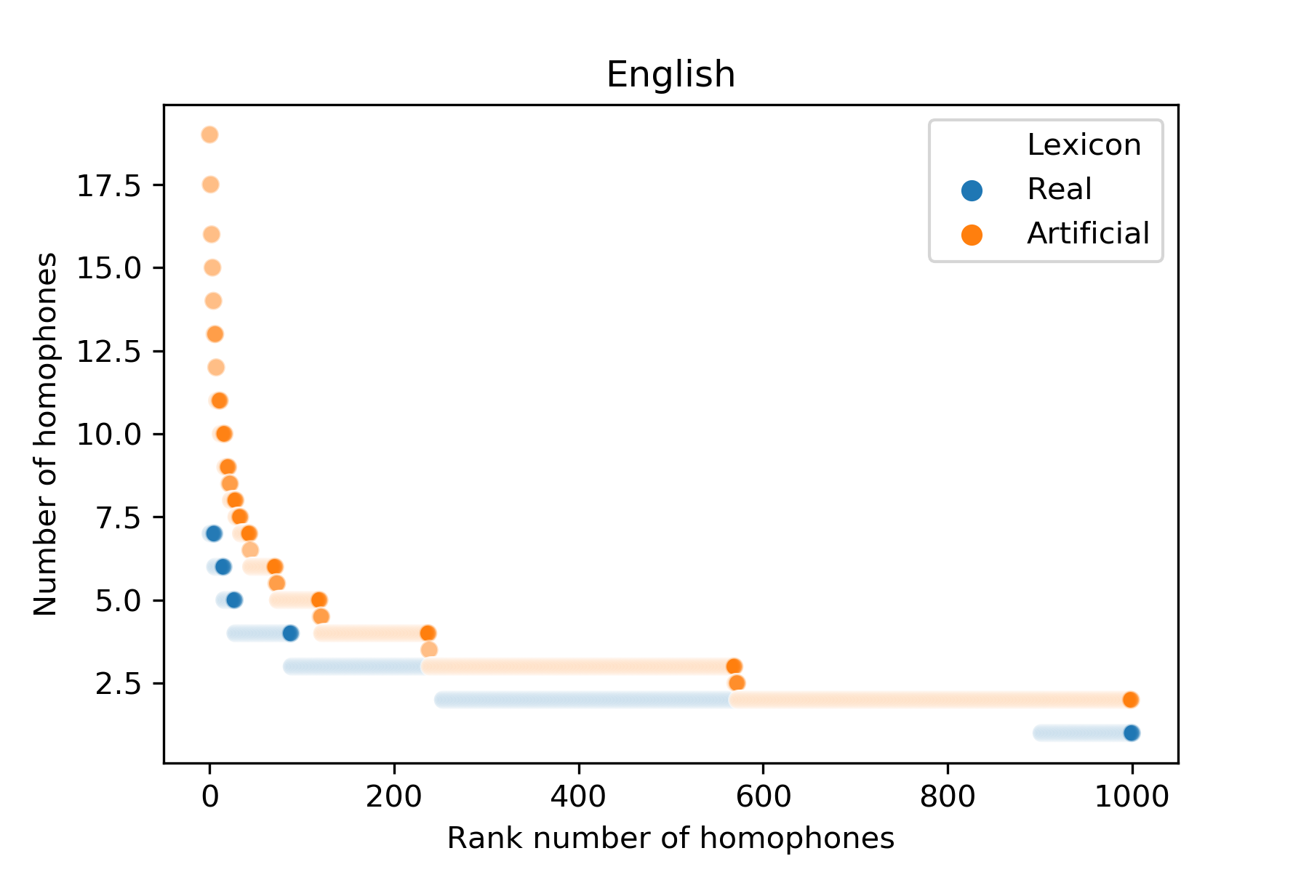
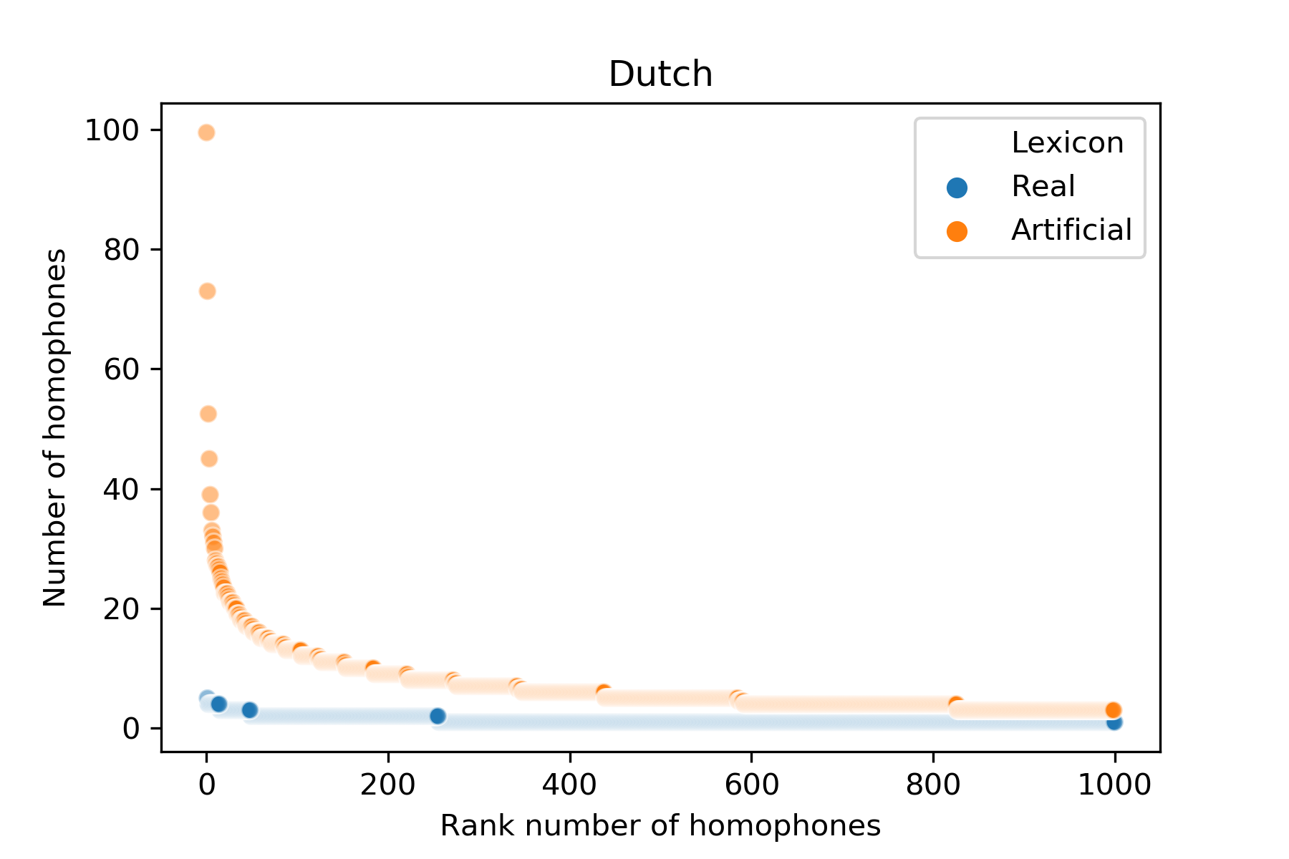
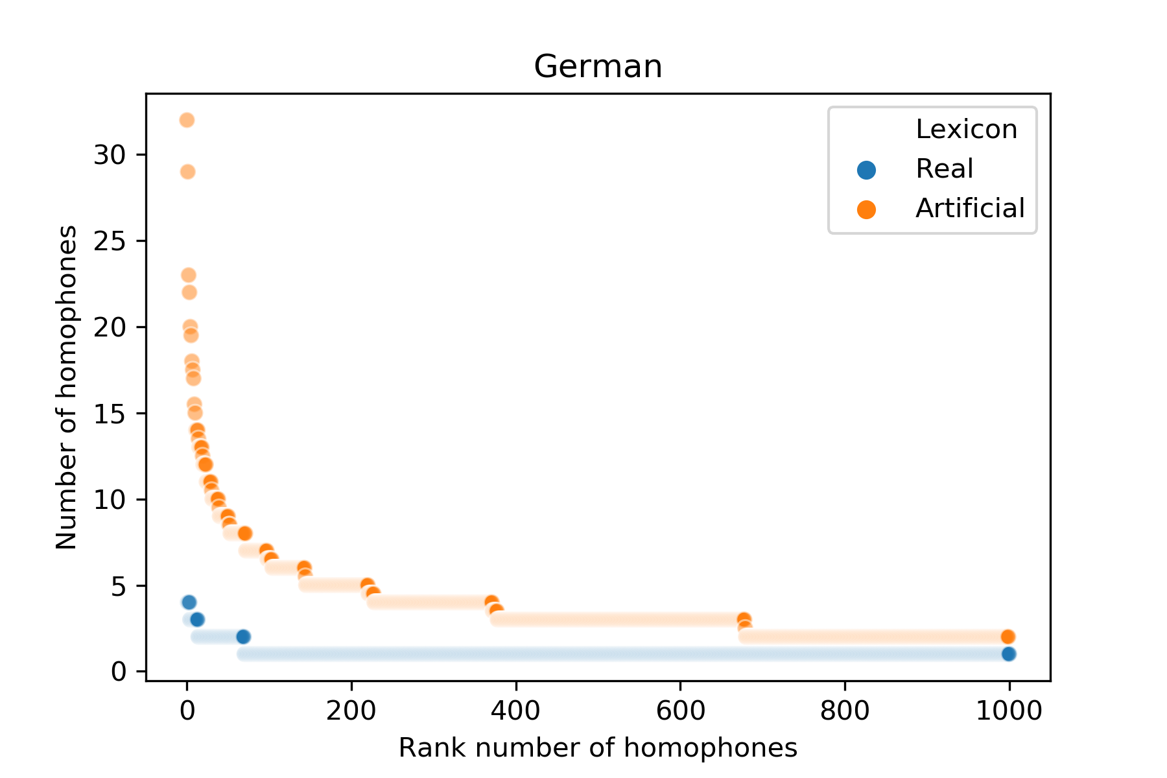
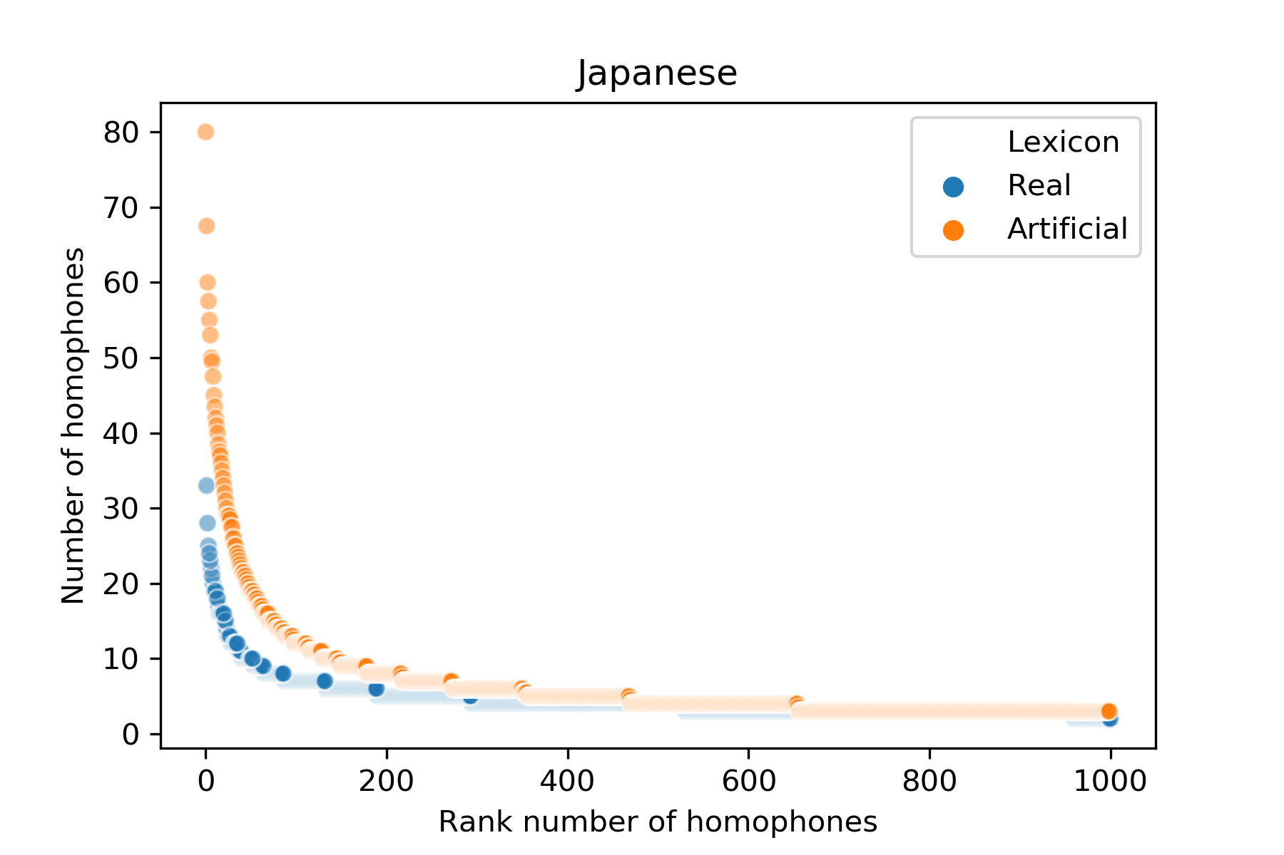
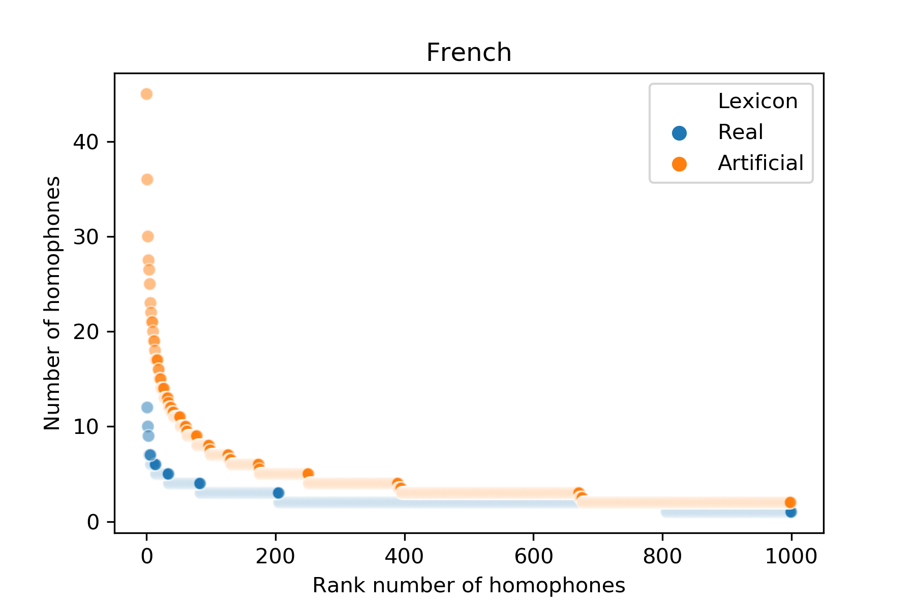
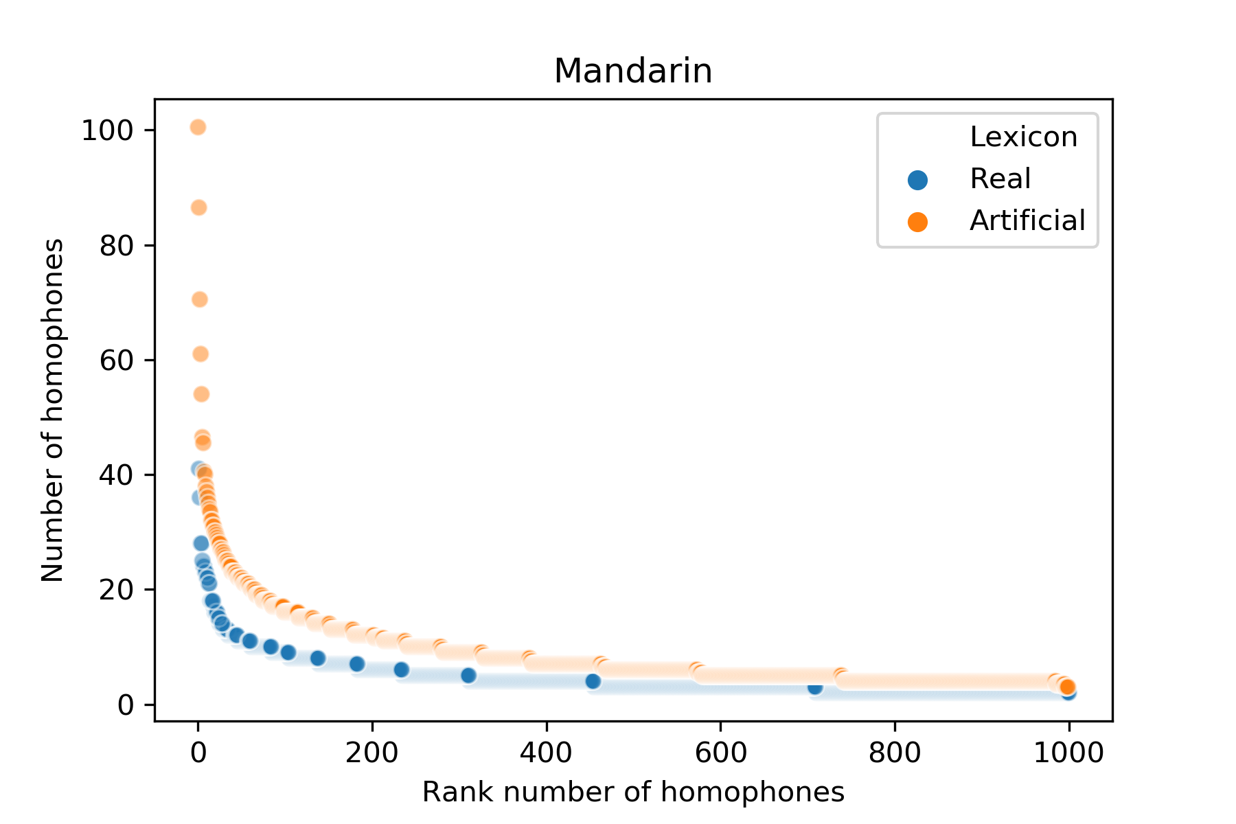
The real lexica exhibit lower upper-bounds on the number of homophones per wordform.
Trott & Bergen, 2020
Notes:
Also larger mean # per wordform.
Homophony Rate is higher in real Japanese, English, and French. (Can show figures on all these things.)
But where in the lexicon are these concentrations of homophones found? Is homophony concentrated among the most “efficient” wordforms?

Slide 34
Generating a lexicon
We then generate a lexicon, with the same #words of each length as the target lexicon.
For each language, we generate 10 artificial lexica using this procedure.
Now, we can compare the artificial baselines to each target lexicon.
How much homophony do they each have?
Where are these homophones concentrated?
Trott, S., & Bergen, B. (2020). Why do human languages have homophones? Cognition, 205, 104449.

Slide 35
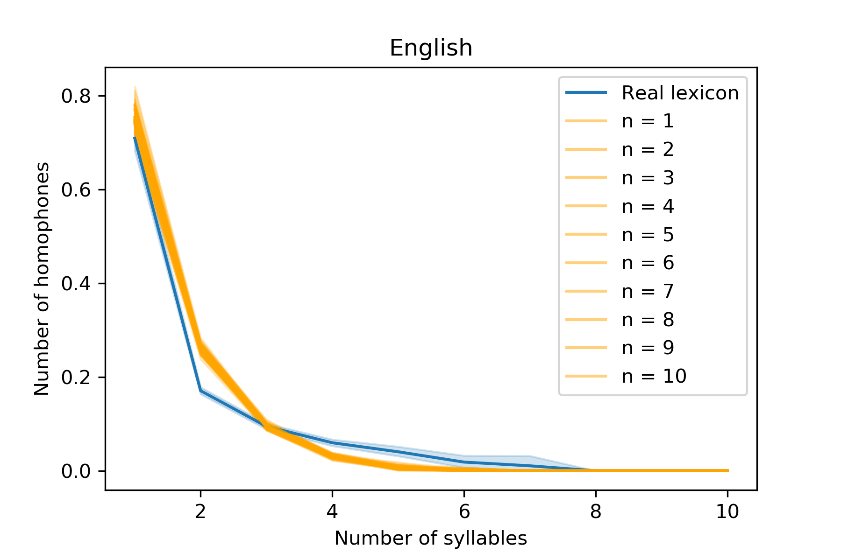
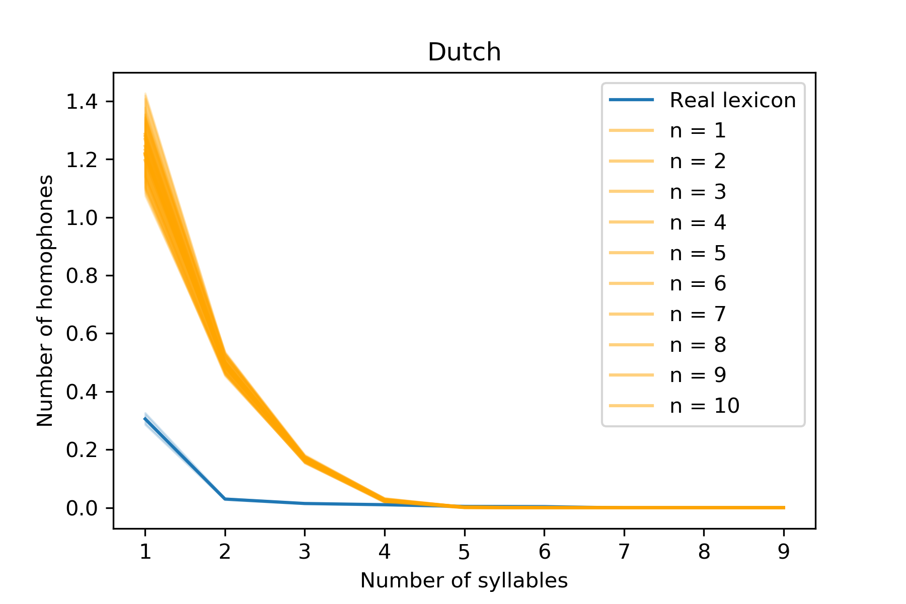
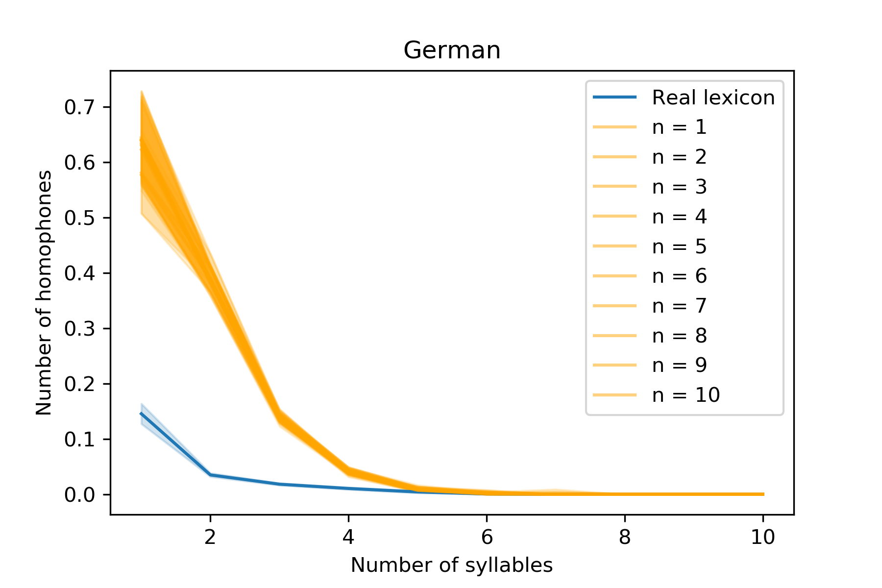
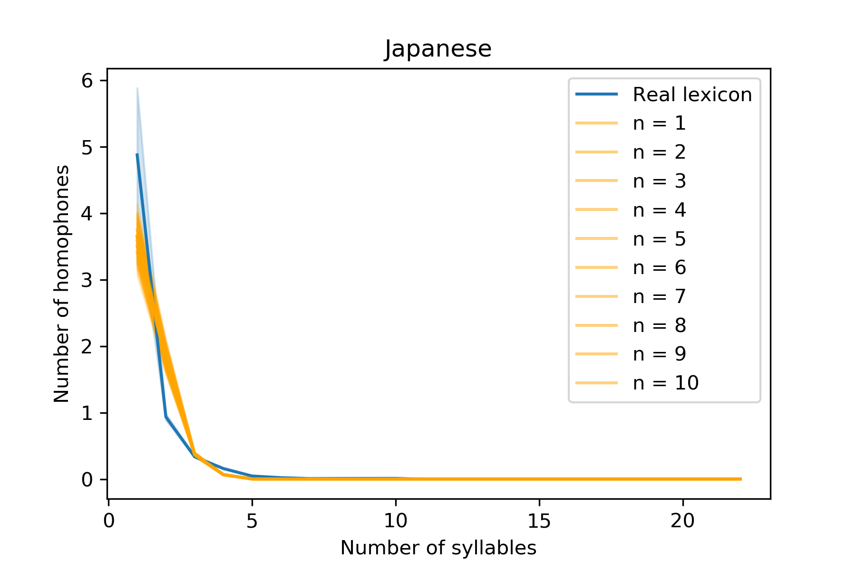
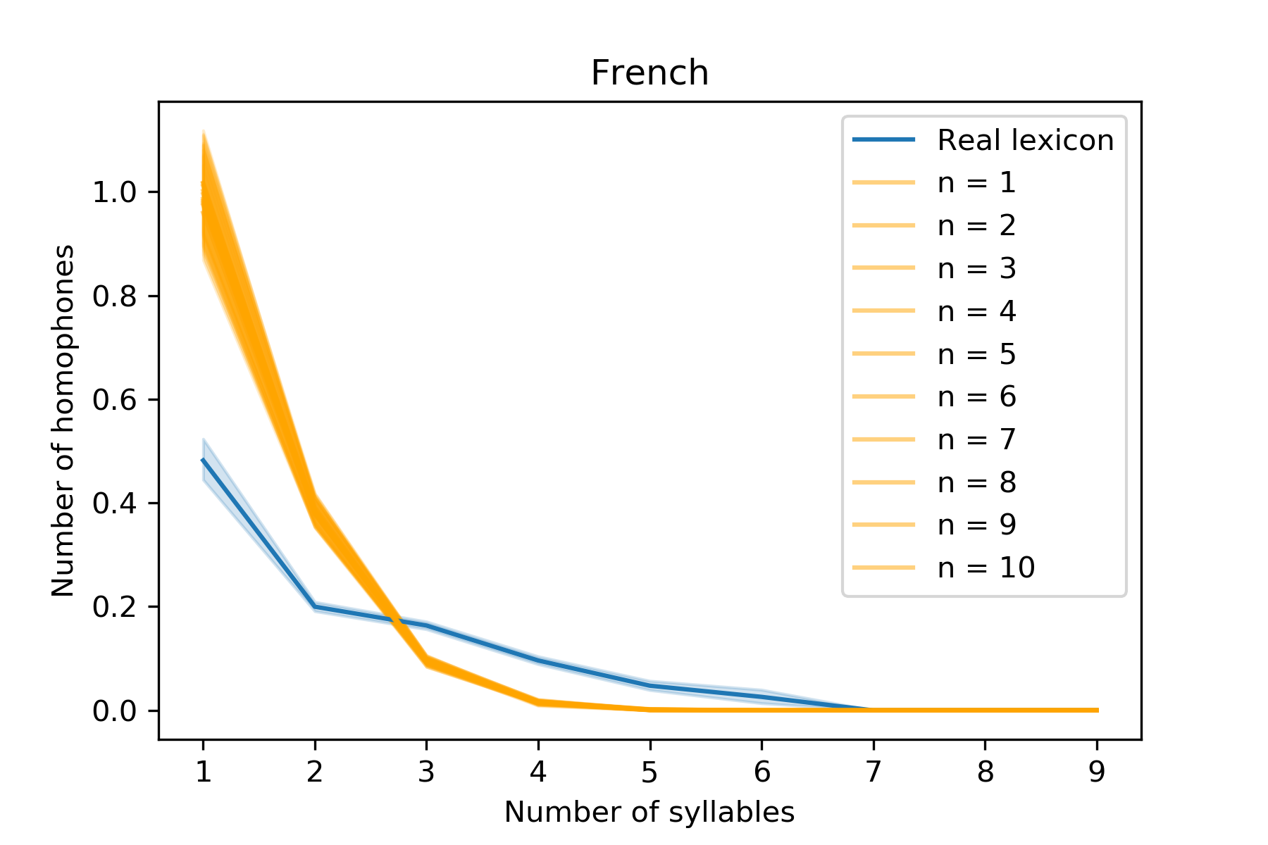
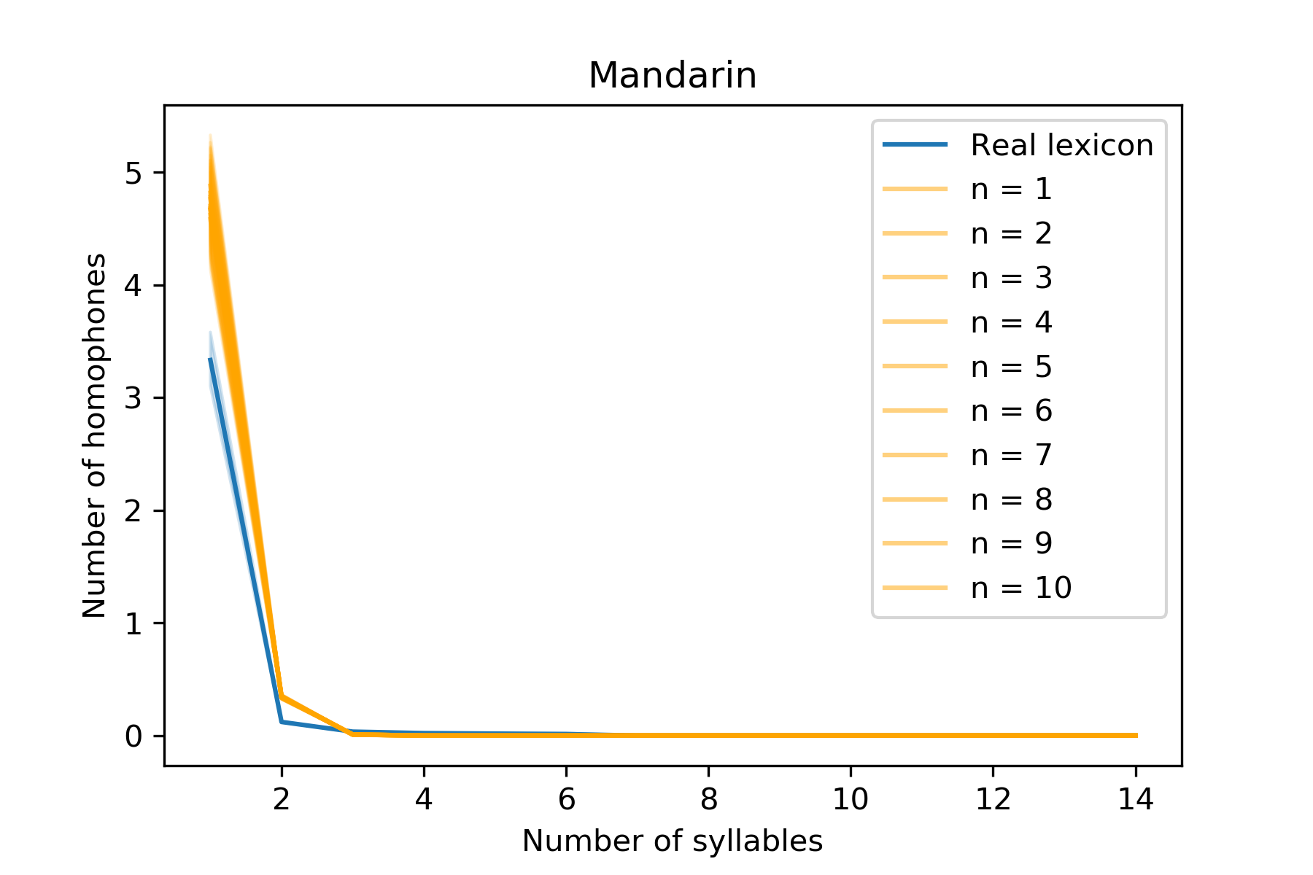
The relationship between length and homophony is at least as strong in the artificial lexica.
Notes:
(And in fact, once you control for phonotactic surprisal, it’s more concentrated among short wordforms.)
(I also worry that the Japanese CallHome Lexicon has some cases of polysemy among the monosyllables, but it’s hard to say.)

Slide 36
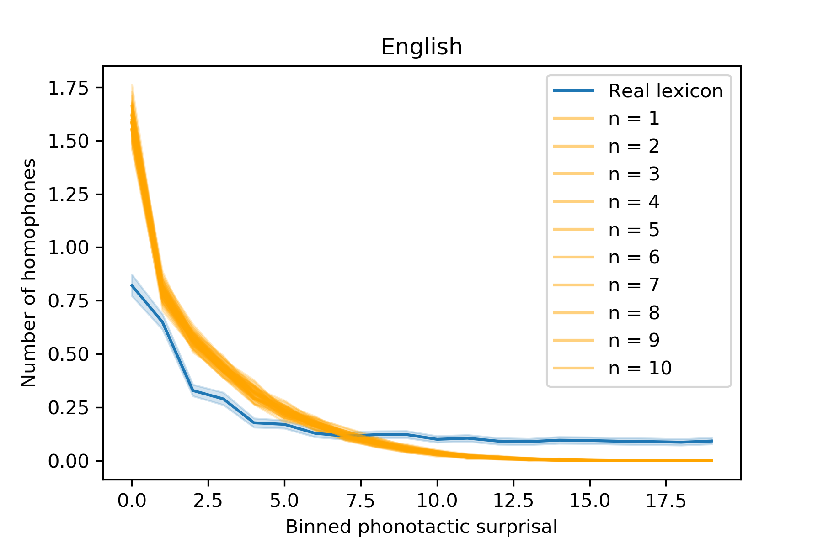
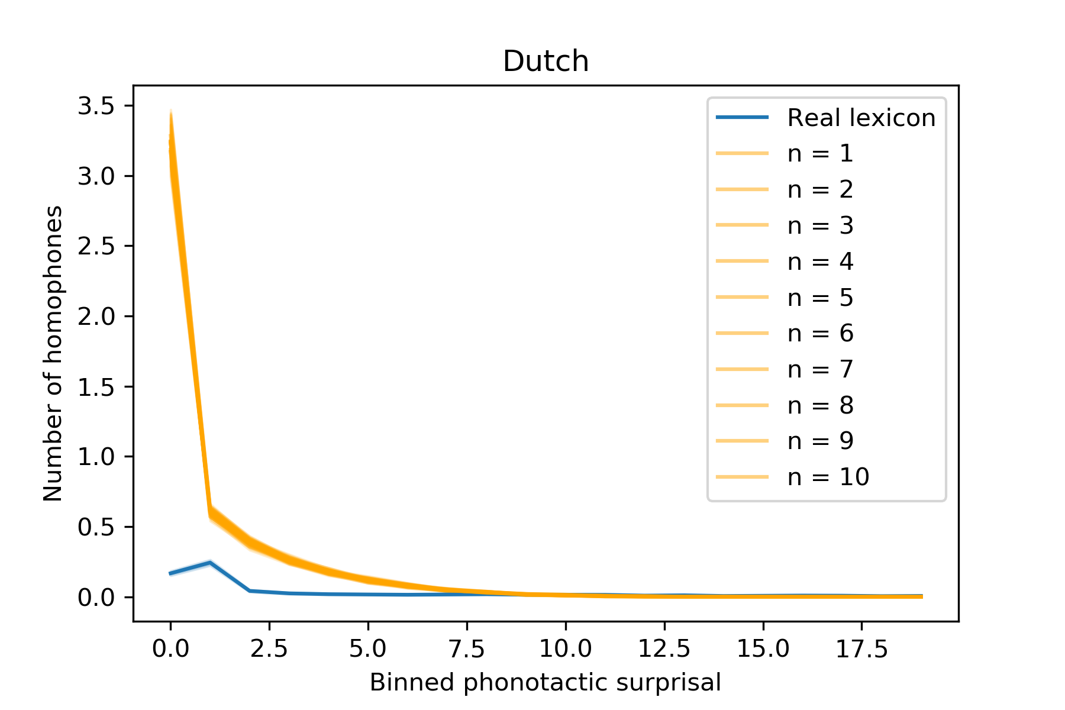
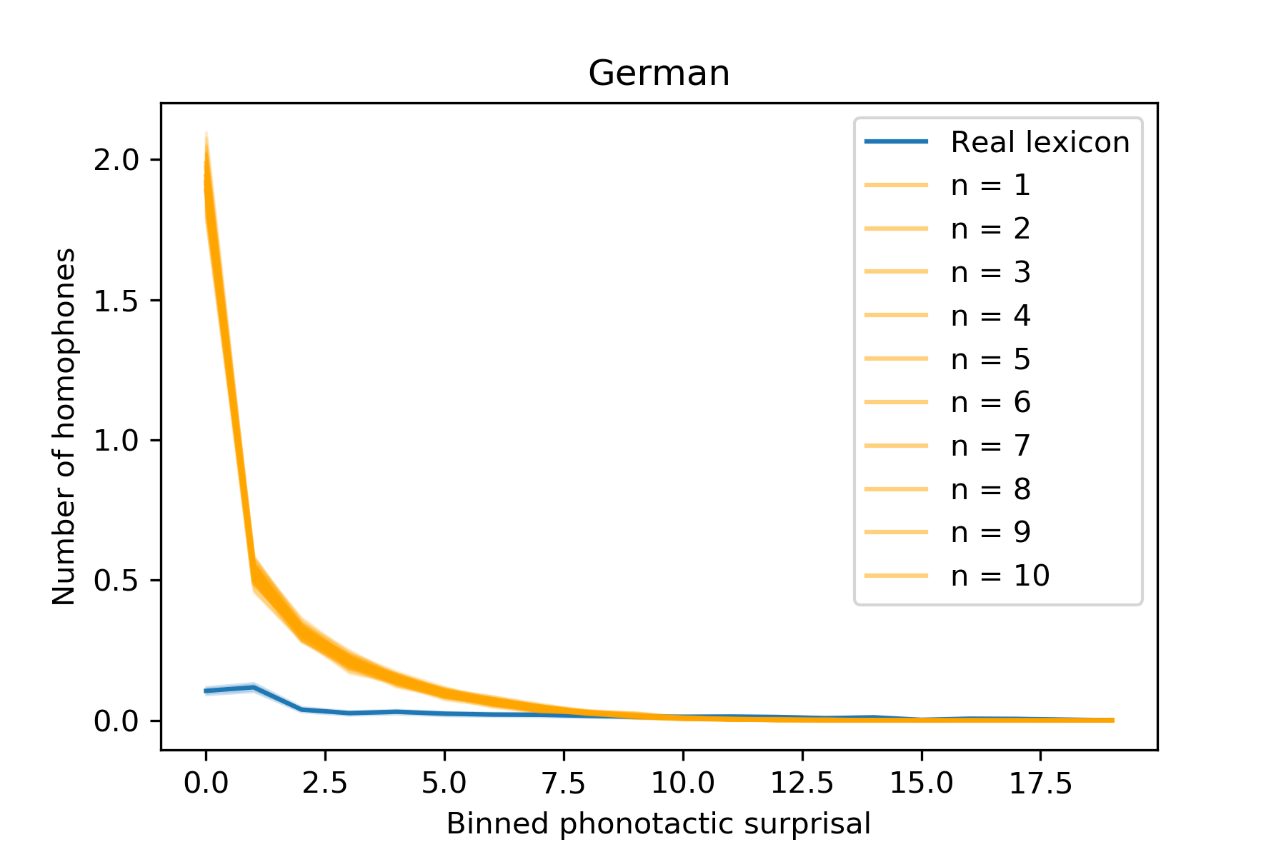
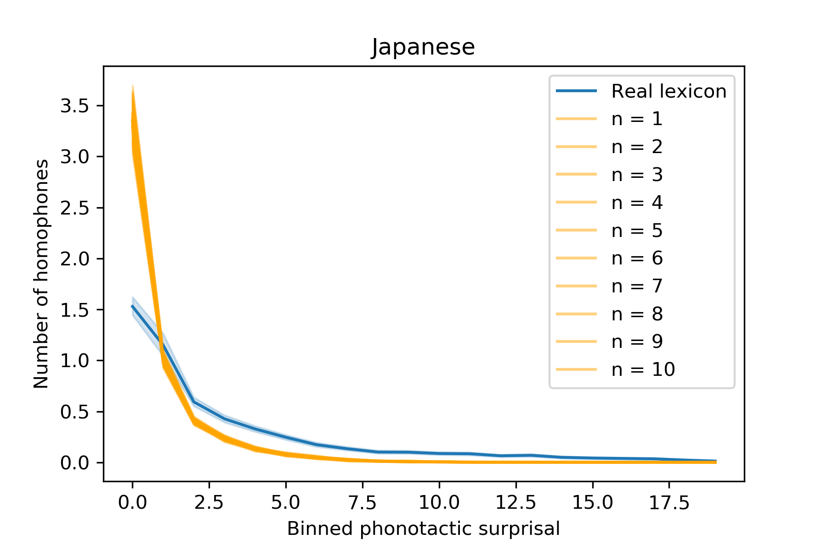
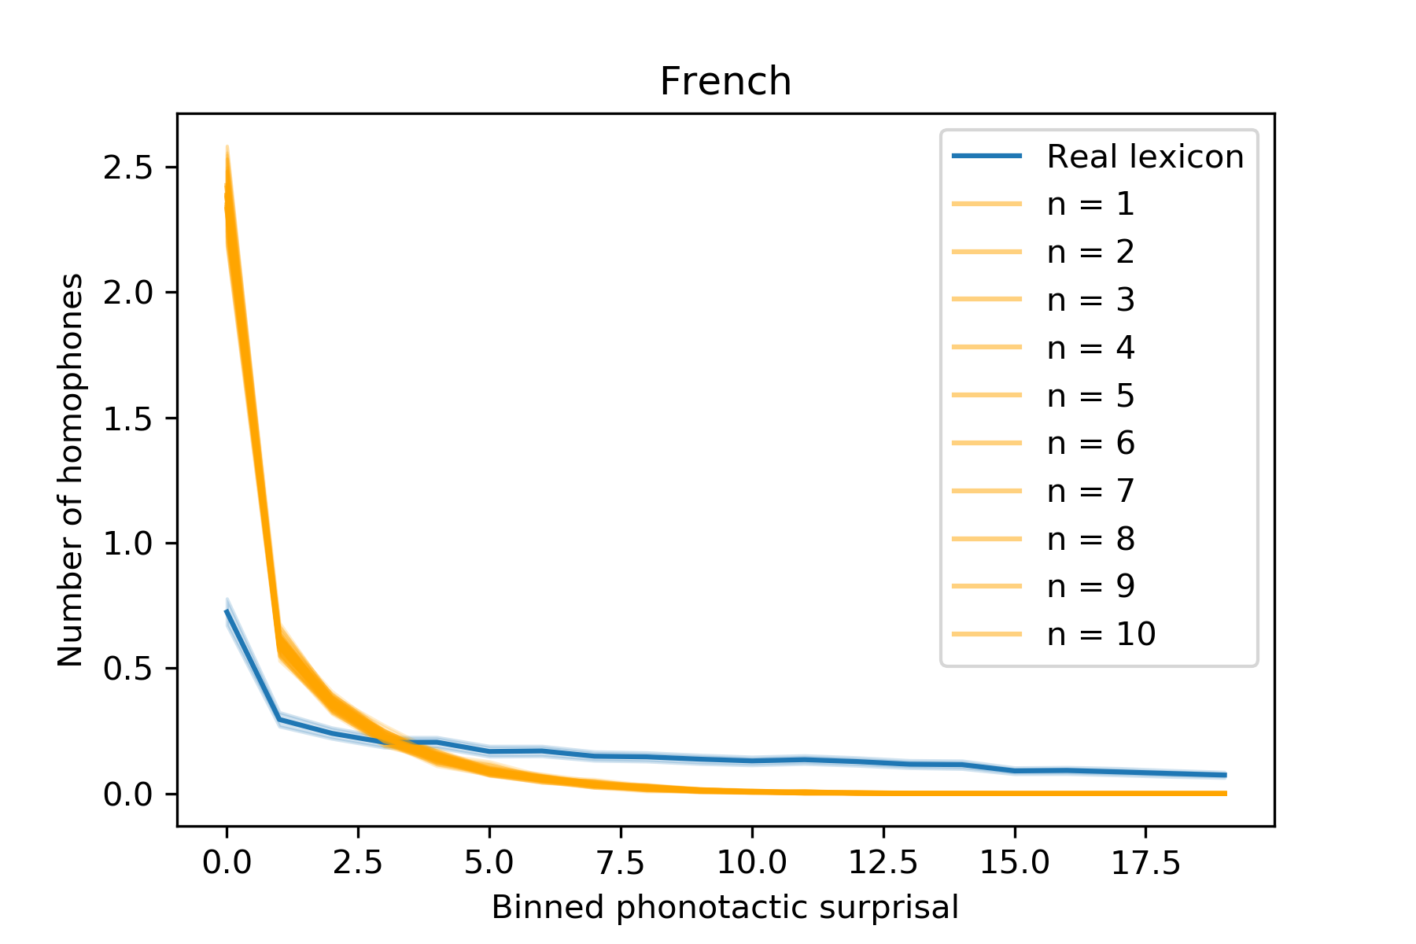
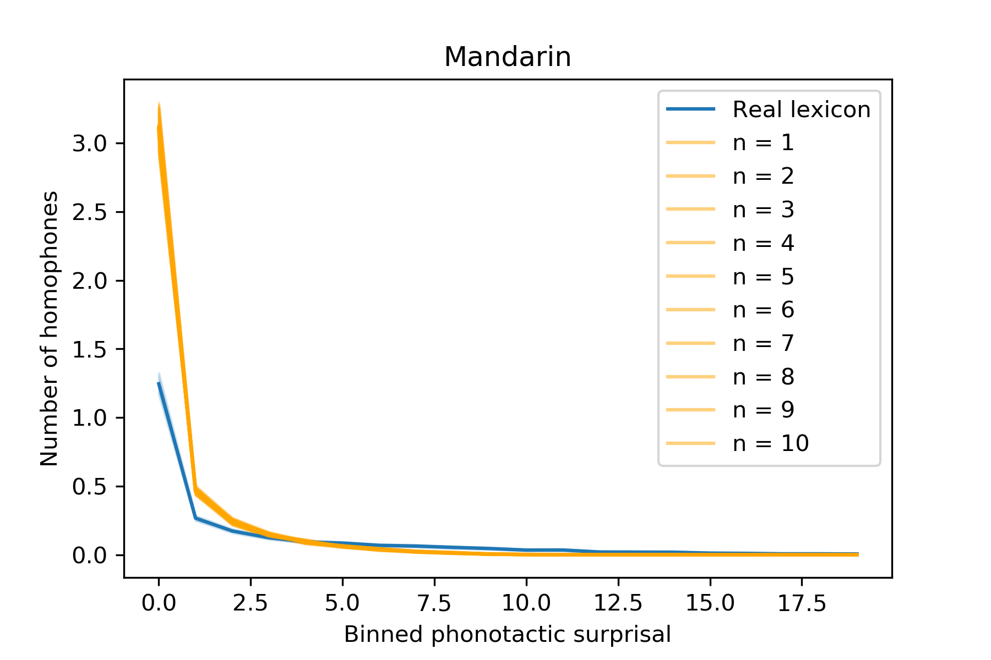
The relationship between phonotactic probability and homophony is at least as strong in the artificial lexica.

Slide 37
Revisiting the puzzle of ambiguity
No evidence for a direct pressure for homophony.
In fact, real lexica may be subject to a pressure against “over-saturation” of the same wordform with many unrelated meanings.
Could such a pressure explain other properties of the lexicon?
Notes:
Mention: there is indeed evidence for anti-homophone pressures at work, e.g., inbhiting certain kinds of sound changes. (Discuss this later)

Slide 38
Real lexica are clumpy
Human lexica have large phonological neighborhoods––they are “clumpy”.
dog
dot
pot
log
cot

Slide 39
Real lexica are clumpy
Human lexica have large phonological neighborhoods––they are “clumpy”.
One explanation is phonotactics.
Each language has rules about which sounds occur in which sequence.
Vitevitch & Aljasser, 2021
This sharply constrains the space of possible wordforms––which should result in some amount of clumpiness.
Dautriche et al., 2017
Yet phonotactics alone are insufficient to account for real neighborhood sizes.
Dautriche et al., 2017

Slide 40
Real lexica are clumpy
Human lexica have large phonological neighborhoods––they are “clumpy”.
One explanation is phonotactics.
Another possibility is dense neighborhoods are selected for.
Dense neighborhoods may facilitate wordform learning.
Coady & Aslin, 2004; Storkel, 2004; Jones & Brandt, 2020
Dense neighborhoods may facilitate wordform production.
Vitevitch, 2002; Vitevitch & Sommers, 2003

Slide 41
Real lexica are clumpy
Human lexica have large phonological neighborhoods––they are “clumpy”.
One explanation is phonotactics.
Another possibility is dense neighborhoods are selected for.
But could clumpiness also be a byproduct of some other selection pressure?
In biology, many beneficial traits emerge as a byproduct of other selection pressures.
Gould & Lewontin, 2989
Candidate pressure: selection against ambiguity?

Slide 42
Real lexica select against over-saturation
Real lexica contain fewer homophones than their phonotactics predict.
Suggests that real lexica select against over-saturation to some degree.
Instead, perhaps real lexica smooth meanings across phonotactic space.
Trott & Bergen, 2020; Caplan et al., 2020; Trott & Bergen, 2022
Could this create larger neighborhoods?

Slide 43
Could smoothing create clumpiness?
With no limit on homophony, many meanings will be assigned to wordforms with high phonotactic probability.
M₁
M₂
“dog”
M₃
M₄

Slide 44
Could smoothing create clumpiness?
But with a constraint on homophony––plus a pressure to use high-probability sequences––some of those meanings will be redistributed across phonotactic space.
“log”
M₁
M₂
“dog”
M₃
“dot”
M₄

Slide 45
Advantages of this account
The pressure against over-saturation is independently motivated.
Could explain a striking dissociation:
Phonotactics alone underestimate neighborhood sizes.
Phonotactics alone overestimate homophony.
Seems more parsimonious to posit a single pressure.
Dautriche et al., 2017
Trott & Bergen, 2020; Caplan et al., 2020; Trott & Bergen, 2022
Under this account, dense neighborhoods are still beneficial––but those benefits are positive externalities created by an anti-homophony pressure.

Slide 46
Testing the byproduct account
As in past work, we simulate a series of phonotactic baselines for each target language (e.g., English) matched for:
Distribution of word lengths in target language
Phonotactics of target language
But we also introduce a limit on homophony.
For each language, compare Neighborhood size across baselines vs. real lexicon.

Slide 47
Real lexica are clumpy
Real lexica have large phonological neighborhoods––they are “clumpy”.
Unlike with homophones, real lexica are clumpier than their phonotactics predict.
One reason could be that neighborhoods are selected for.
May facilitate wordform learning
May facilitate word production
Dautriche et al, 2017
Jones & Brandt, 2020
Vitevitch, 2002

Slide 48
Real lexica are clumpy
Real lexica have large phonological neighborhoods––they are “clumpy”.
Unlike with homophones, real lexica are clumpier than their phonotactics predict.
One reason could be that neighborhoods are selected for.
But could large neighborhoods also result from an anti-homophone pressure?
Empirically, we do observe a dissociation.
Dautriche et al, 2017

Slide 49
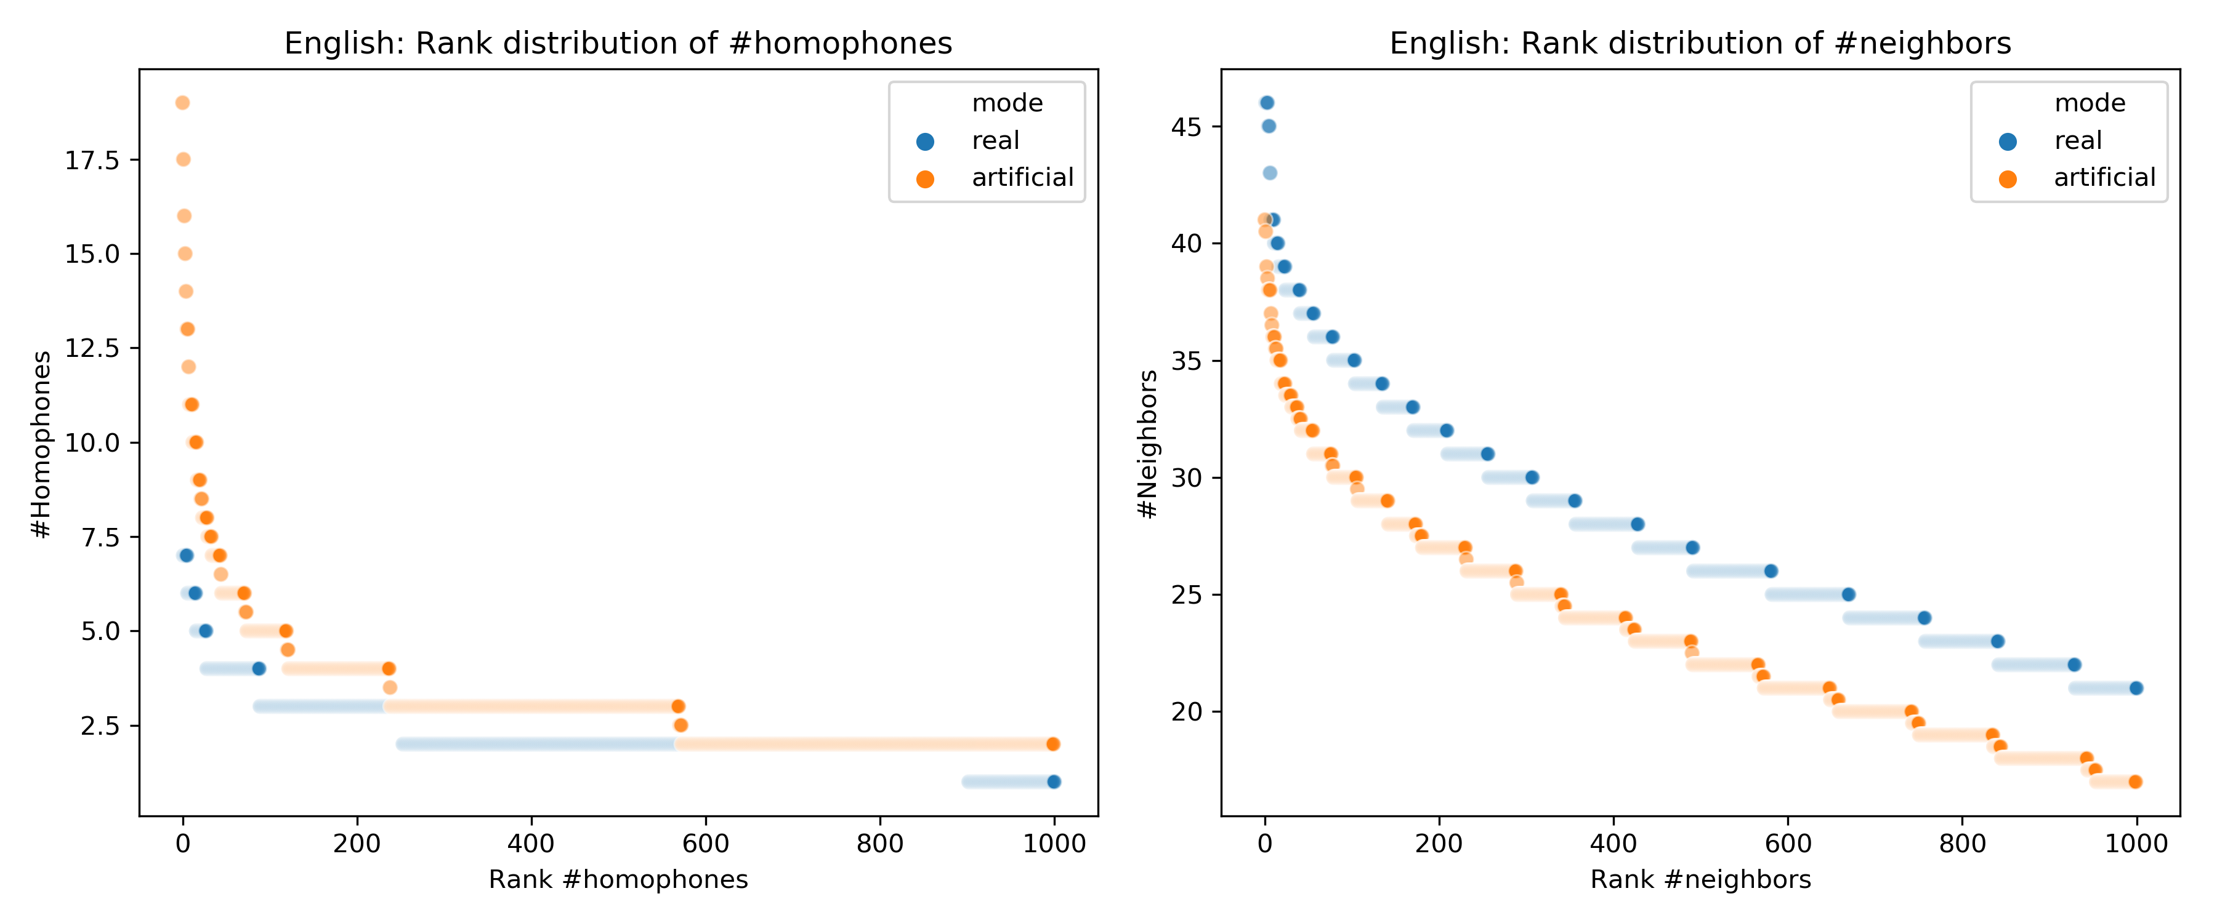
Homophones vs. neighborhoods

Slide 50
Testing the byproduct account
As in past work, we simulate a series of phonotactic baselines for each target language (e.g., English) matched for:
Distribution of word lengths in target language
Phonotactics of target language
But we also introduce a limit on homophony.
For each language, compare Neighborhood size across baselines vs. real lexicon.

Slide 51
Neutral model: lexicon generation
We then generate a lexicon, with the same #words of each length as the target lexicon.
Phonotactic model (English)
dot
7K
1-syllable words
15K
2-syllable words
11K
3-syllable words

Slide 52
Neutral model: lexicon generation
We then generate a lexicon, with the same #words of each length as the target lexicon.
Phonotactic model (English)
dot
7K
1-syllable words
15K
2-syllable words
11K
3-syllable words

Slide 53
Neutral model: lexicon generation
We then generate a lexicon, with the same #words of each length as the target lexicon.
Phonotactic model (English)
7K
1-syllable words
15K
2-syllable words
11K
3-syllable words

Slide 54
Neutral model: lexicon generation
We then generate a lexicon, with the same #words of each length as the target lexicon.
Phonotactic model (English)
dog
7K
1-syllable words
15K
2-syllable words
11K
3-syllable words

Slide 55
Neutral model: lexicon generation
We then generate a lexicon, with the same #words of each length as the target lexicon.
Phonotactic model (English)
If a bucket is already “full”, we throw away that candidate word.
7K
1-syllable words
15K
2-syllable words
11K
3-syllable words

Slide 56
Neutral model: lexicon generation
We then generate a lexicon, with the same #words of each length as the target lexicon.
Phonotactic model (English)
We continue this process until every bucket is full.
7K
1-syllable words
15K
2-syllable words
11K
3-syllable words

Slide 57
Neutral model: lexicon generation
We then generate a lexicon, with the same #words of each length as the target lexicon.
Phonotactic model (English)
We continue this process until every bucket is full.
7K
1-syllable words
15K
2-syllable words
11K
3-syllable words

Slide 58
Anti-homophone model
If a given word w has been added too many times already, we throw it out and resample.
Phonotactic model (English)
dot
dot; gub; hug
7K
1-syllable words
15K
2-syllable words
11K
3-syllable words

Slide 59
Anti-homophone model
If a given word w has been added too many times already, we throw it out and resample.
Phonotactic model (English)
dot
dot; gub; hug
7K
1-syllable words
15K
2-syllable words
11K
3-syllable words

Slide 60
Anti-homophone+ model
If a given word w has been added too many times already, we convert it to a neighbor.
Phonotactic model (English)
dot
dot; gub; hug
7K
1-syllable words
15K
2-syllable words
11K
3-syllable words

Slide 61
Anti-homophone+ model
If a given word w has been added too many times already, we convert it to a neighbor.
Phonotactic model (English)
dot
dog
dot; gub; hug
7K
1-syllable words
15K
2-syllable words
11K
3-syllable words

Slide 62
What is “too many” homophones?
We force each nth-ranked word to be no more homophonous than the equivalently-ranked wordform in the real lexicon.

Slide 63
Generating a lexicon
For each language, we generate 10 artificial lexica for each baseline using this procedure.
English
Dutch
German
French
Mandarin
We also identified the optimal n for each language’s phonotactic model.

Slide 64
Generating a lexicon
For each language, we generate 10 artificial lexica for each baseline using this procedure.
English
Dutch
German
French
Mandarin
How do Neighborhood Sizes compare across the baselines vs. their real counterparts?

Slide 65
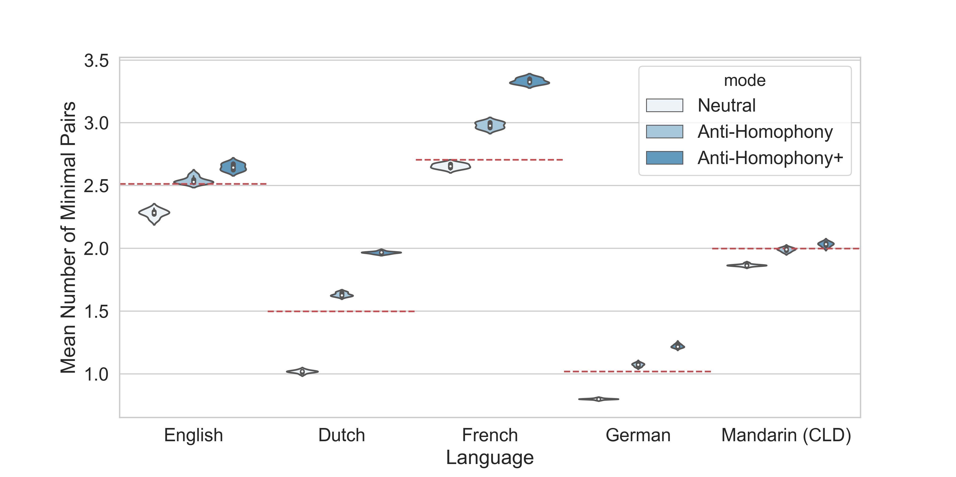

Slide 66
As before, the “Neutral” baselines have smaller neighborhoods than their real counterparts (dotted red line).

Slide 67
But the Anti-Homophony baselines have neighborhoods that are at least as large, on average.

Slide 68
And the Anti-Homophony+ baselines consistently overestimate neighborhood size.

Slide 69
Two birds with one stone?
An anti-homophone pressure is sufficient to account for the average size of phonological neighborhoods.
This is more parsimonious than positing two distinct pressures.
If true, the benefits of dense neighborhoods are “positive externalities”.
Notes:
(Distinguish sufficiency from necessity)

Slide 70
Ambiguity: the role of frequency
Across 100+ languages, frequent wordforms are also more ambiguous.
Could subserve efficiency––frequent wordforms easier to produce, etc.
But also seems counterintuitive: why force comprehenders to disambiguate so frequently?
Unfortunately, we can’t easily simulate “frequency” in a baseline.
We need a different kind of approach.
Zipf, 1949; Bond et al., 2019
Piantadosi et al., 2012

Slide 71
Ambiguity: the role of frequency
Rather than generating a new lexicon from scratch, we can calculate how many homophones each wordform ”should” have––using its normalized phonotactic probability.
/st﻿eɪk/
p(/st﻿eɪk/) = 0.0009
M₇₇₀₆
Wordform
Phonotactic probability
#Meanings available to wordforms of this length

Slide 72
Ambiguity: the role of frequency
Rather than generating a new lexicon from scratch, we can calculate how many homophones each wordform ”should” have––using its normalized phonotactic probability.
/st﻿eɪk/
p(/st﻿eɪk/) = 0.0009
M₇₇₀₆
$$Ε_{w}=p_{w}∗M_{n}−1=0.0009∗7706−1=6.94 −1=5.94$$
If meanings were assigned based on phonotactic probability alone, /st﻿eɪk/ should have 5.94 homophones.

Slide 73
Ambiguity: the role of frequency
Rather than generating a new lexicon from scratch, we can calculate how many homophones each wordform ”should” have––using its normalized phonotactic probability.
What is the relationship between frequency and expected # homophones?
Is this larger or smaller than the relationship between frequency and the actual # homophones?

Slide 74
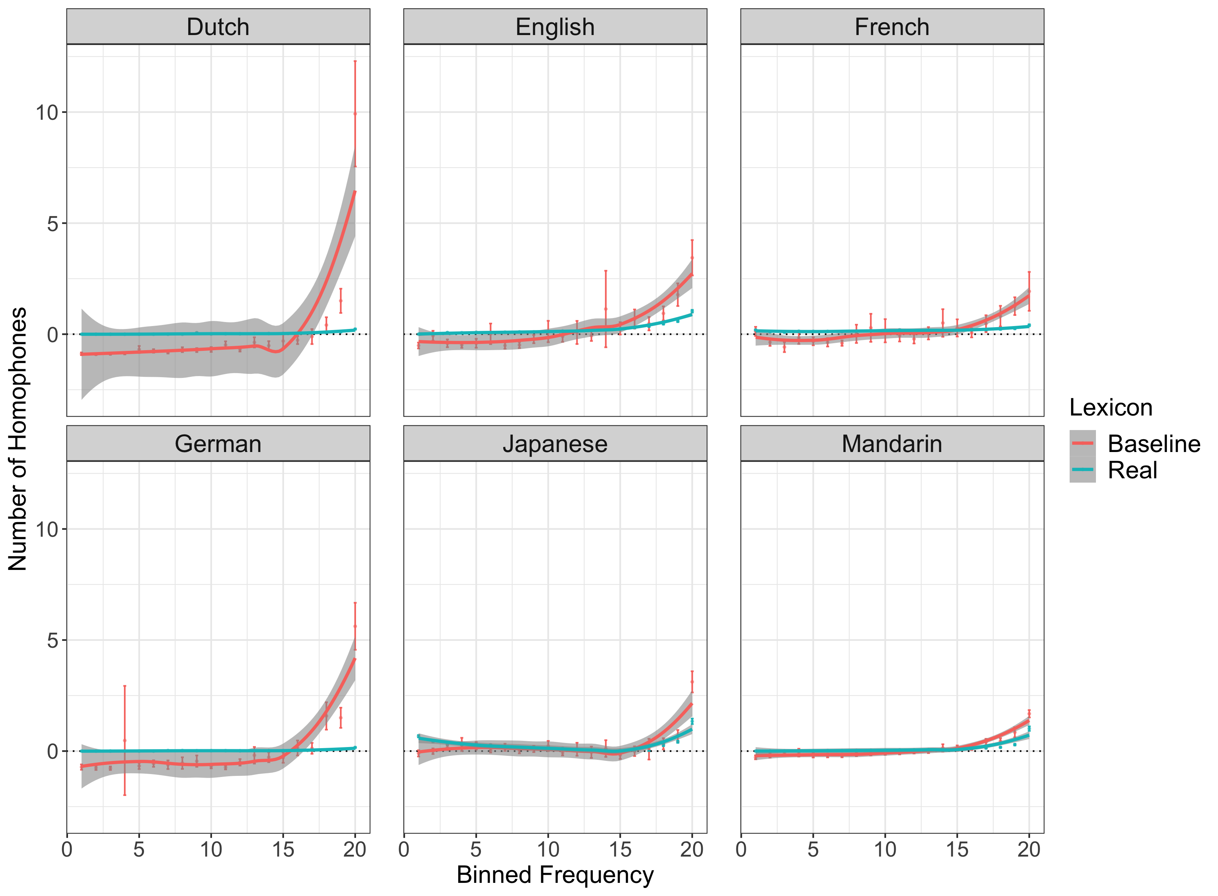
Across each language, the baseline lexicon exhibits a stronger relationship between frequency and #homophones than the real lexicon.
I.e., frequent wordforms are less ambiguous than their phonotactics predict.
Trott, S., & Bergen, B. (2022). Languages are efficient, but for whom? Cognition, 225, 105094.

Slide 75
A pressure to avoid frequent ambiguity?
Frequent wordforms are less ambiguous than predicted by a neutral baseline.
This could reflect a pressure to reduce the cost of frequent disambiguation.
Perhaps a comprehender-centric pressure shaping the lexicon?

Slide 76
A tale of two pressures
According to Zipf (1949), real languages reflect a compromise between competing pressures.
Unification
A pressure to “compress” lots of different meanings into a single signal.
Diversification
A pressure to be “informative”––different signals for each meaning.
But this isn’t an explanation––are the pressures equal in size, or is one larger than the other?
Trott & Bergen (2022): at least when it comes to ambiguity ~ frequency, a pressure for diversification seems to win out.

Slide 77
Whose efficiency?
Many argue that languages are speaker-oriented––is this a counterexample?
Identifying trade-offs is only half the battle––we need models that make precise, testable predictions.
These models help us avoid the trap of teleology: not everything is the result of a direct selection pressure.
To go further, we also need mechanistic models: what are the processes by which a plausible pressure is implemented?
Levinson, 2000; MacDonald, 2013
Gould & Lewontin, 1979
Trott & Bergen, 2020;
Caplan et al, 2020;
Pimentel et al., 2021
Wedel et al., 2013

Slide 78

Thank you!
Language and Cognition Lab
James Michaelov
Cameron Jones
Tyler Chang
Other collaborators
Federico Rossano
Katherine DeLong
Eva Wittenberg
Nancy Chang
Tiago Torrent
Nathan Schneider
Arturs Semenuks
Nicolas Ruytenbeek
Dissertation Committee
Benjamin Bergen (chair + PI)
Victor Ferreira
Marta Kutas
Seana Coulson
Ndapa Nakashole
Research Assistants
Stefanie Reed
Alex Liebscher
Dan Kaliblotzsky
Cohort
Ethel Lu
Friends and family
Pamela Rivière

Slide 79
Bonus Slides

Slide 80
RAW-C Task

Slide 81
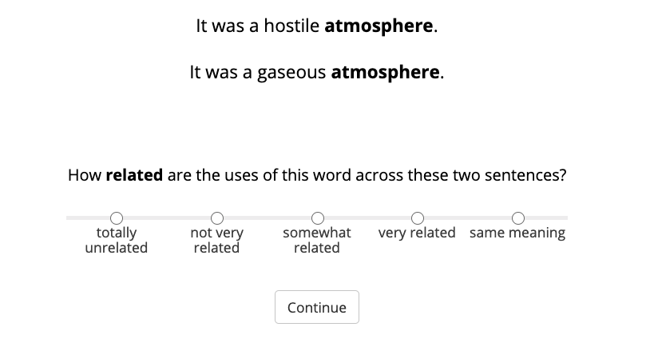
Norming study: obtained relatedness judgments for each sentence pair (N = 77).
Average inter-annotator agreement: Spearman’s rho = 0.79 (median = 0.81).
Notes:
Briefly re-review psycholinguistic evidence. Now focus on plausibility judgments.

Slide 82
Other results: Chapters 2-4

Slide 83
Main effect of Cosine Distance, beyond Sense Boundary and Ambiguity Type.
p < .0001
Disconfirms both theories in the Mental Dictionary Framework.
Notes:
Main effect doesn’t look super impressive, but note that this includes several subjects with unusually slow RTs (on the order of 10-15 seconds).

Slide 84
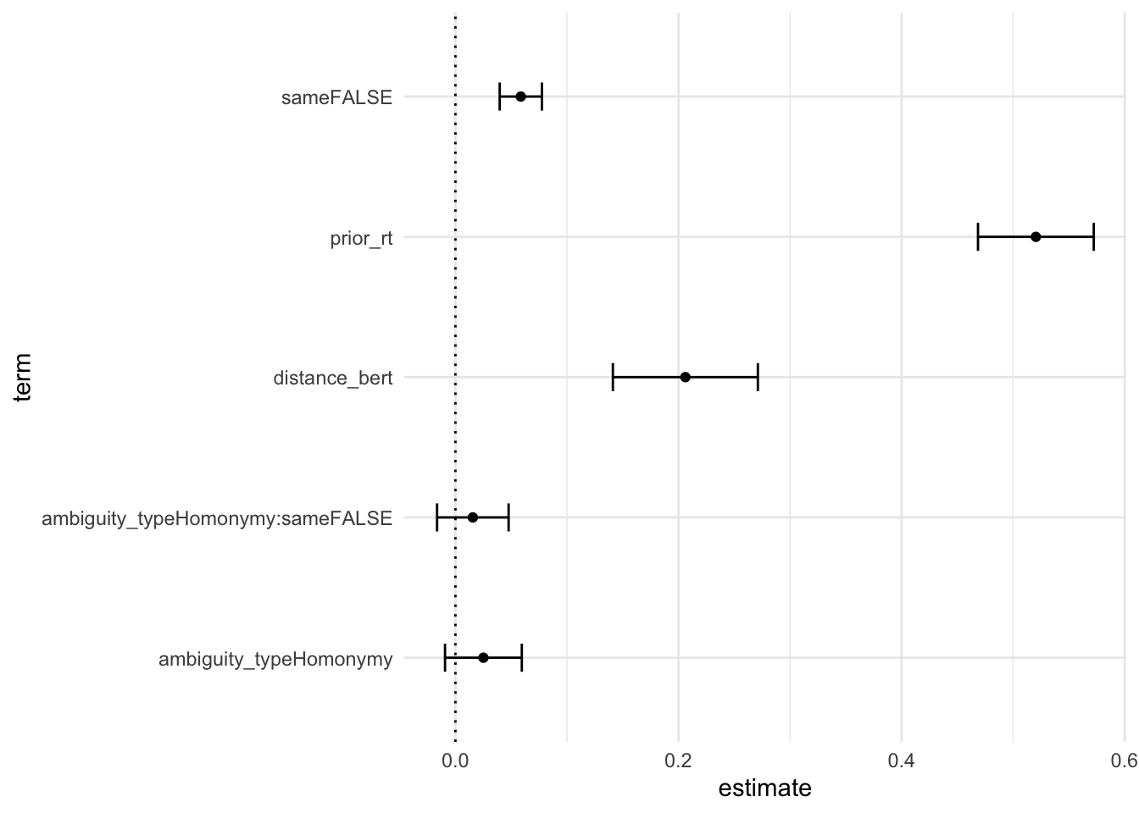
Notes:
Main effect doesn’t look super impressive, but note that this includes several subjects with unusually slow RTs (on the order of 10-15 seconds).

Slide 85
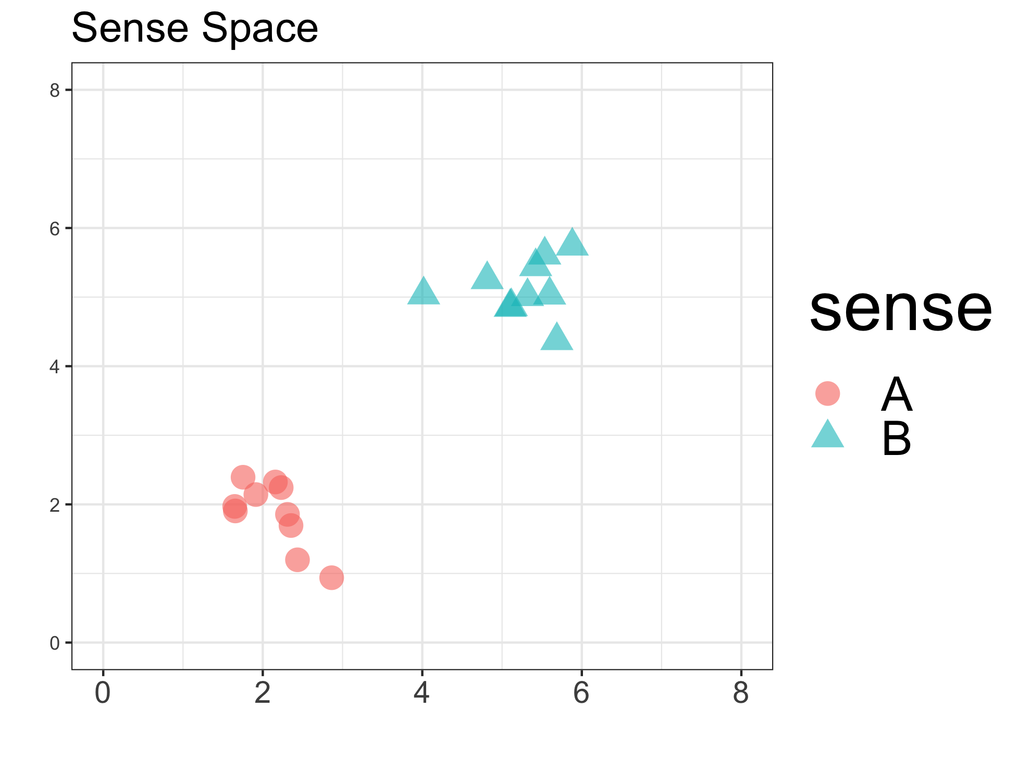
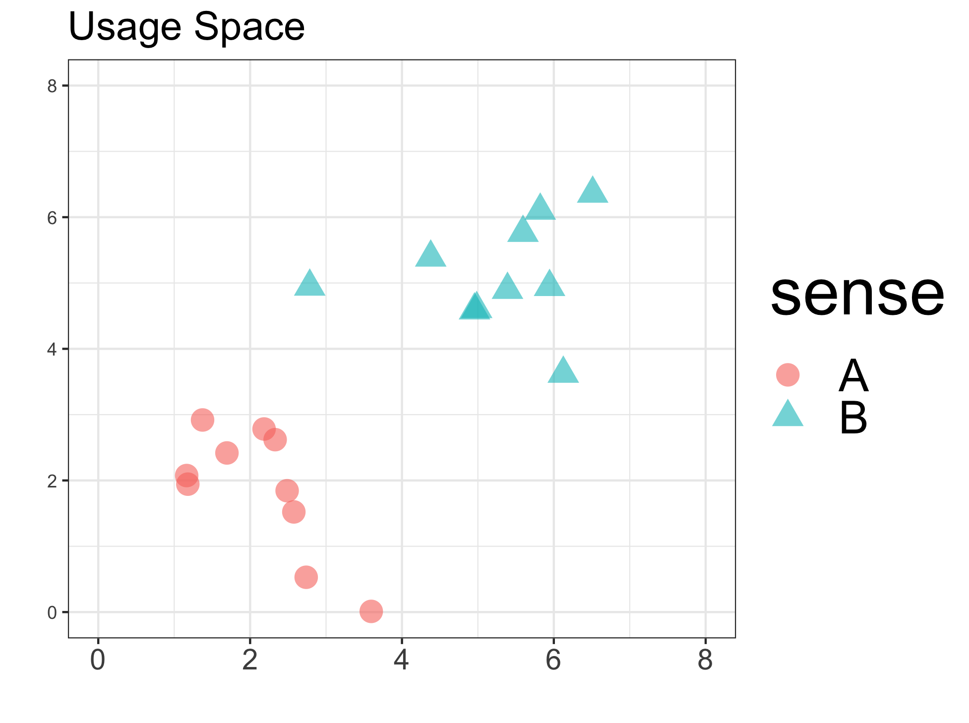
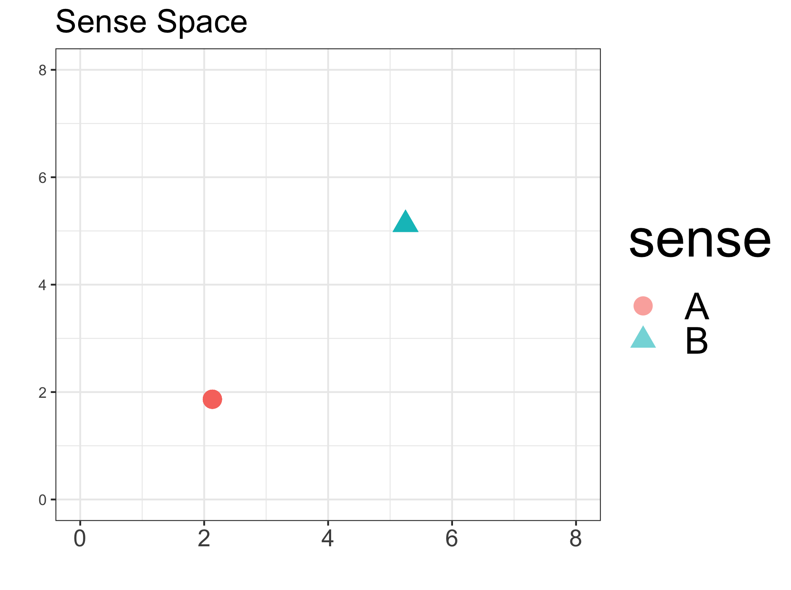
Sense Compression vs. Sense Distillation?
Variance within sense-clusters should predict RT.
Variance within sense-clusters should not predict RT.
Notes:
We can actually also adjudicate between tehse theories. Sense Compression predicts that within-cluster variance (i.e., within same sense category) should still predict RT. Sense Distillation

Slide 86
Sense Compression vs. Sense Distillation?
Graded effects even within Same Sense usages.
Notes:
(Note: effect is clearer if we exclude the slowest RTs.)

Slide 87
Sense Compression vs. Sense Distillation?
Graded effects even within Same Sense usages.
Notes:
(Note: effect is clearer if we exclude the slowest RTs.)

Slide 88
Mental Dictionary Framework
Wordforms map onto distinct “entries” in a mental lexicon.
Ambiguous wordforms map onto multiple entries.
Core Representation
Sense Enumeration
Pustejovsky, 1995;
Cruse, 1986
Kempson, 1977
Homonymy/polysemy dichotomy likely too simple––degree of overlap is also predictive.
Polysemous meanings should not be distinguishable from same sense uses
Polysemy should elicit distinct behavior than homonymy
Polysemous meanings should be distinguishable from same sense uses
Polysemy should not elicit distinct behavior than homonymy
Klepousniotou & Baum, 2007;
Brown, 2008
Notes:
Note: The prediction that polysemy = same sense is a little dependent on exactly how these “rules” get implemented. So theoretically, CR could be salvaged by positing that differences in behavior are due to differences in applying the rule.

Slide 89
Compared each contextualized judgment to LS Norms.
Contextualized sensorimotor properties appear to reflect word senses (physical market vs. financial market).
Can we also calculate a sensorimotor distance between each context?

Slide 90
Other results: Chapters 5-7

Slide 91
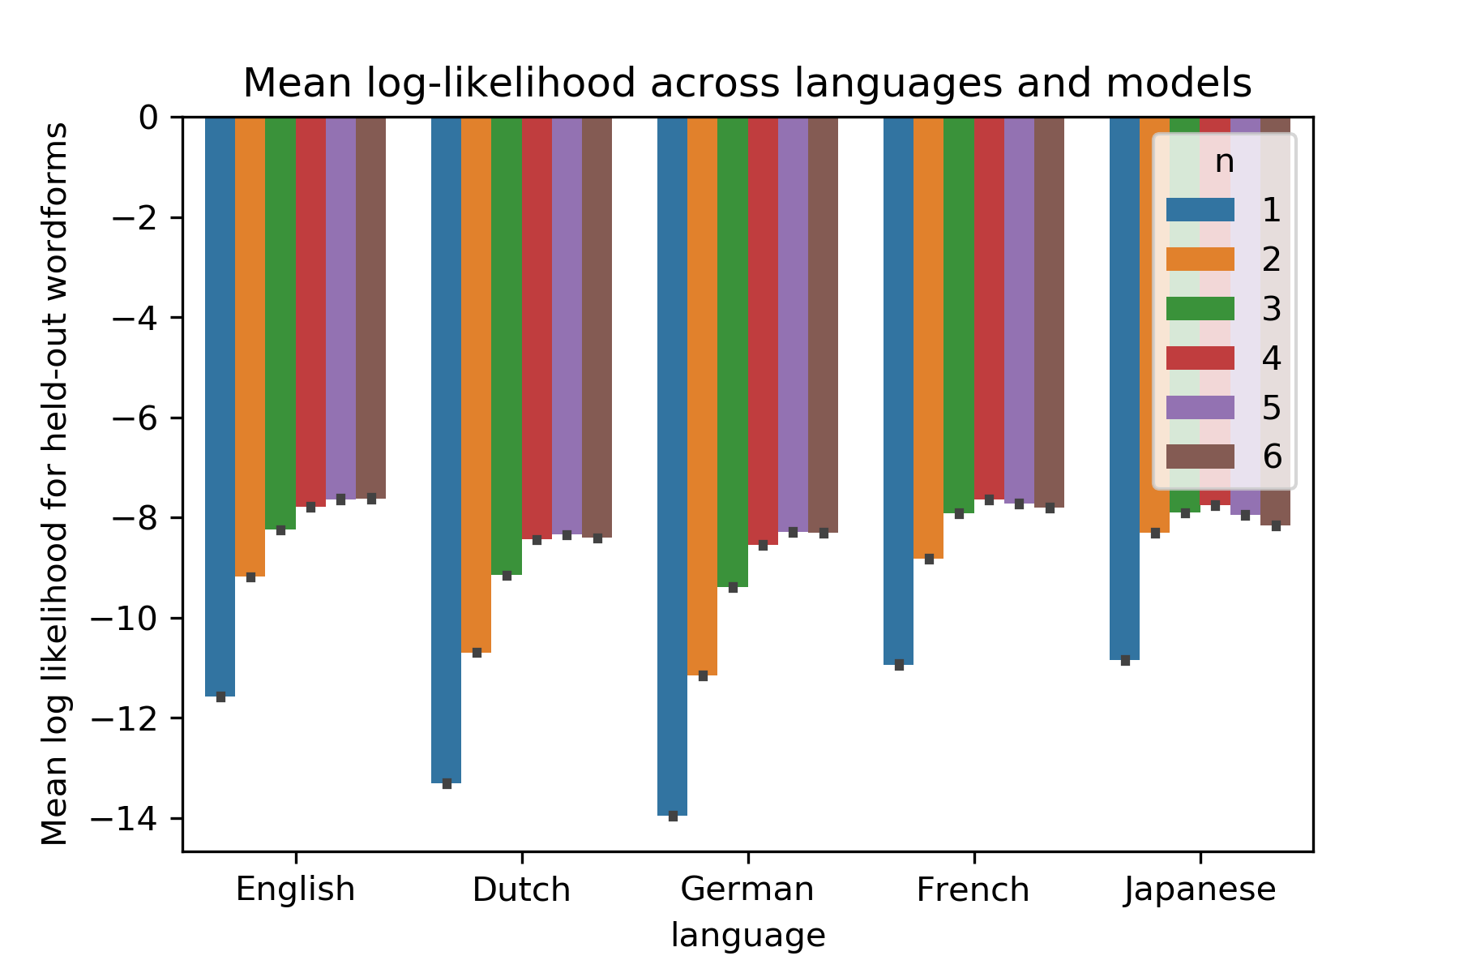

Slide 92
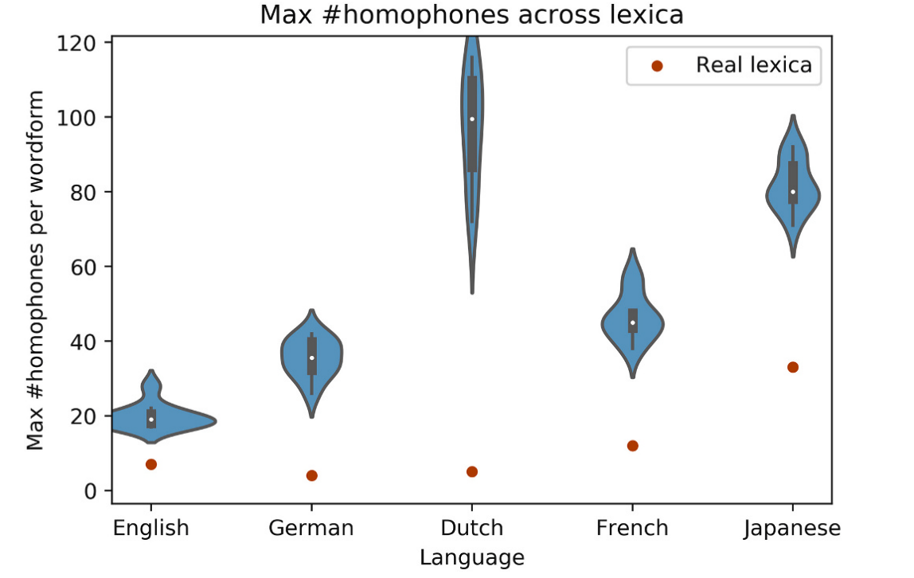
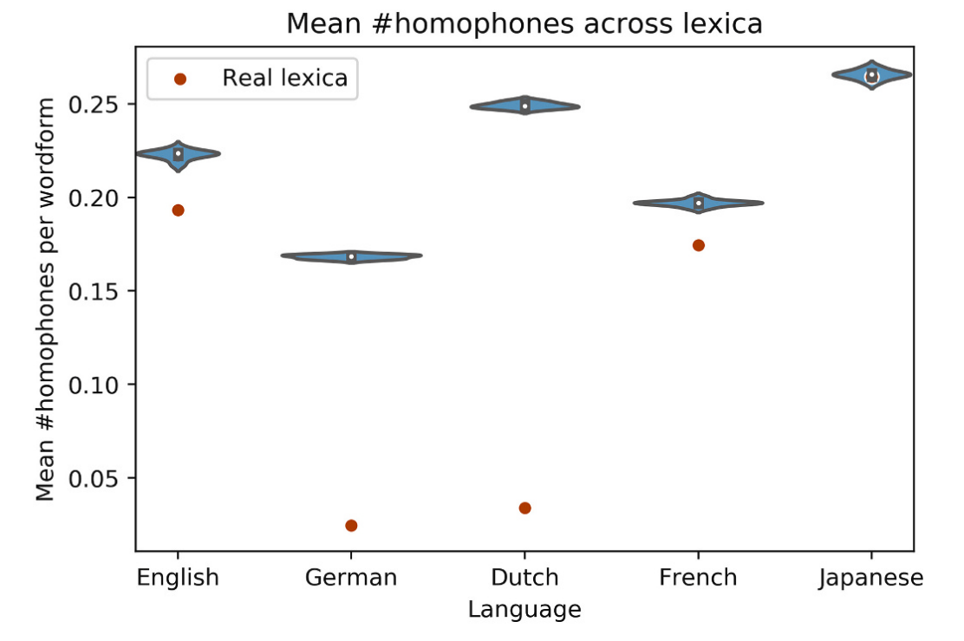

Slide 93
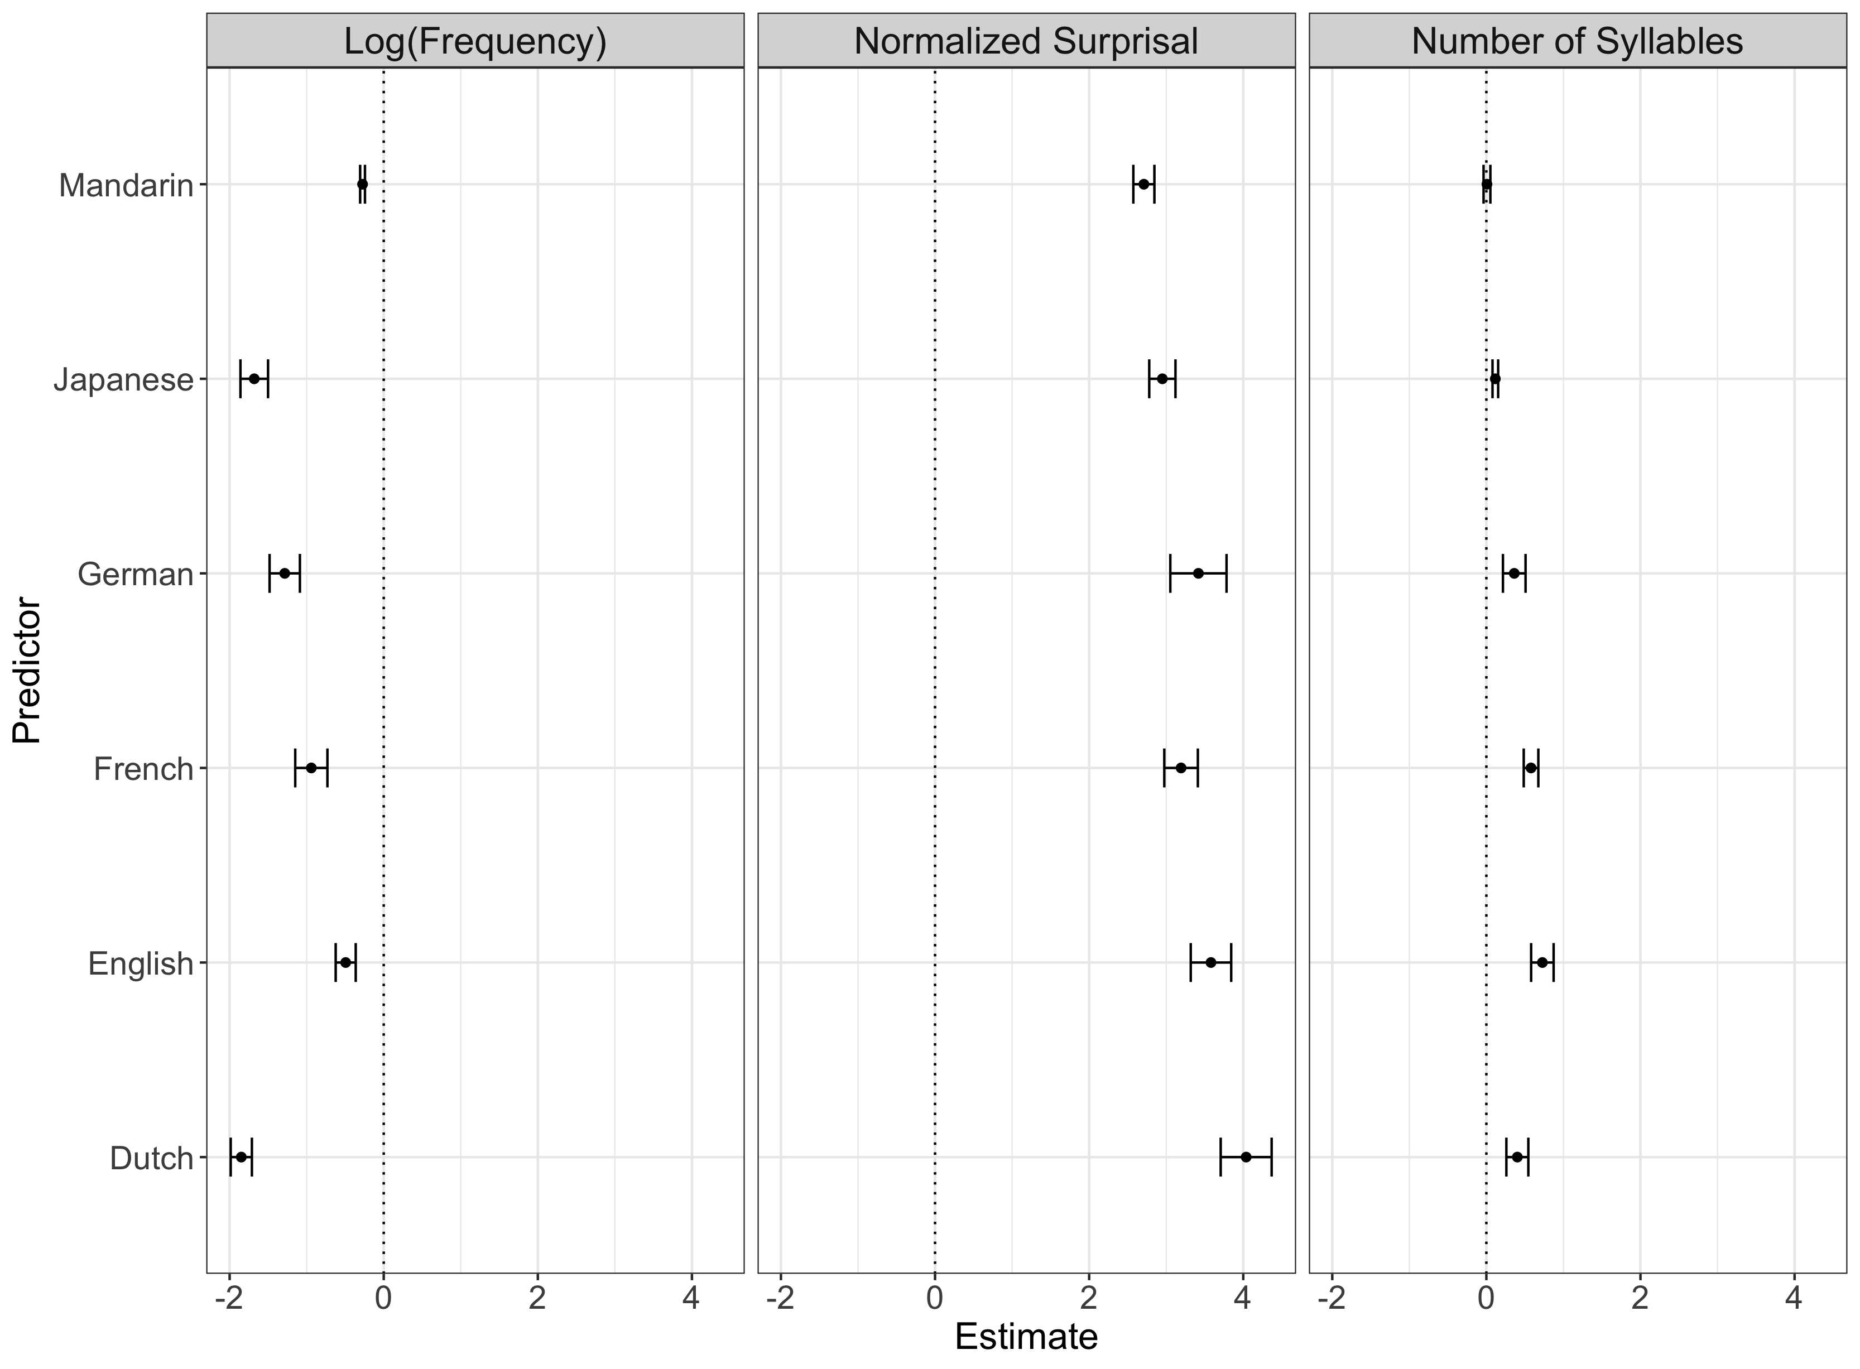

Slide 94
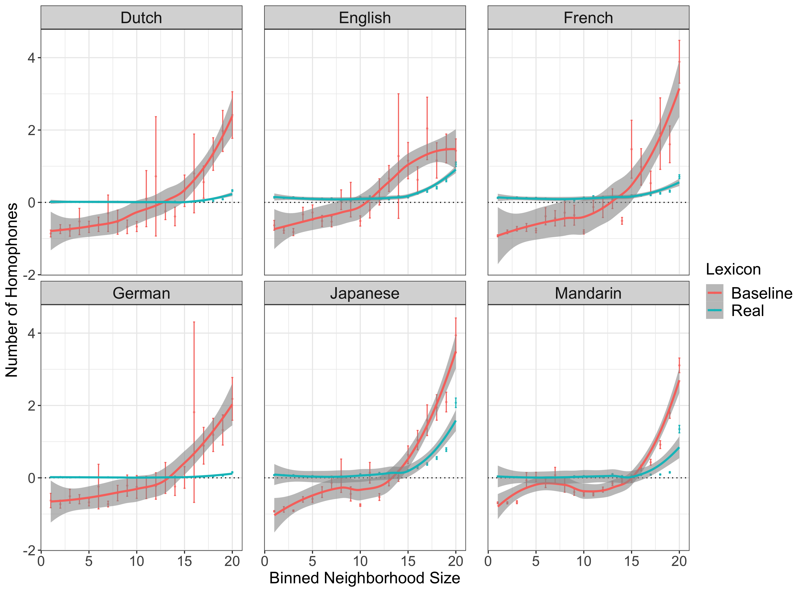

Slide 95
Philosophy of baselines
Sufficiency ≠ necessity
A baseline can only demonstrate whether a simpler set of mechanisms/factors is sufficient to explain some phenomenon.
It doesn’t entail that those mechanisms are therefore the correct explanation.
Other factors are still relevant––how plausible is this explanation?
Still, it introduces uncertainty into our accounts––can’t just point to empirical phenomenon as evidence of theory, must adjudicate between theory and baseline.

